Slide 1
Ann schliep utah purchasing division
A MULTISTATE CONTRACT FOR WALK-IN BUILDING SUPPLIES

Slide 2
Before we start
Please mute your phone and do not use your hold button
This webinar is being recorded
Copies of this webinar and the power point will be posted on the NASPO ValuePoint contract portfolio website at the conclusion of todays presentation
Please hold your questions until the end

Slide 3
Sourcing Team
Shirley Smith Oregon
Gail Burchett Nevada
Cheryl Warren Nevada
Lisa Bradley Oklahoma
Jason Grove Alaska
Andy Mobley South Dakota
Phyllis Richey Arkansas
Robert Zalucki Connecticut
Peter Hunter Connecticut
Arianne Quignon Idaho
Maureen Barends Massachusetts
Shannon Berry, NASPO ValuePoint

Slide 4
Purpose
To establish multiple Master Agreements for the purchase of walk-in building supplies by state governments (including departments, agencies, institutions), institutions of higher education, political subdivisions (i.e., colleges, school districts, counties, cities, etc.), the District of Columbia, territories of the United States, and other eligible entities subject to approval of the Participating Entity’s procurement director and compliance with local statutory and regulatory provisions (“Purchasing Entities”).

Slide 5
Benefits of Agreements
Provides comprehensive inclusion on a specific commodity that allows for economic ordering quantities.
Award to one vendor to provide services nationally for purchasing entities.
Deliver long range stabilization of market indices by using indefinite delivery concept.
Obtain more favorable pricing than previously obtained by individual state’s or local government entities.
Allowed for Added Value services.

Slide 6
Scope of Services
1. HVAC
2. Automotive Tools
3. Jan/San
4. Electrical
5. Fasteners
6. Hand Tools
7. Lamps/Ballasts
8. Material Handling
9. Power Sources
10. Outdoor Garden
11. Paint
12. Plumbing
13. Pneumatic Tools
14. Power Tools
15. Safety
16. Security
17. Welding/Soldering
18. All other items in retail stores not already mentioned above

Slide 7
RFP Process
RFP Process | Date
RFP Advertised | June 8, 2016
Questions / Requests for Clarification Due | June 22, 2016
Answers / Clarification Issued (approx.) | July 6, 2016
Closing (Proposals Due) | August 16, 2016
Evaluation Period | August 17, 2016 – October 7, 2016
Notice of Award | November 18, 2016
Award Protest Period Ends | November 28, 2016

Slide 8
RFP Process continued
Number of Proposals Received: 3
1 of 3 Offerors were responsive.
Evaluation of proposals by sourcing team.
2 Offerors not given award. (One did not meet Mandatory Minimums and the other did not meet the technical minimum score threshold of 300 points).
Negotiations with Offeror.

Slide 9
Evaluation Criteria
Minimum Mandatory Requirements (pass/fail)
Agreement to Insurance Requirements
Agreement to NASPO ValuePoint Administrative Fees
Agreement to cooperate with NASPO ValuePoint and BidSync with providing unique information and ordering instructions.
Total of 1000 points were possible
500 for technical
500 for cost
Technical Criteria
Inventory and Store Locations (50 points)
Customer Service/Emergency Service (75 points)
Contract Management (75 points)

Slide 10
Evaluation Criteria
Technical Criteria
Inventory and Store Locations (50 points)
Customer Service/Emergency Service (75 points)
Contract Management (75 points)
Implementation (50 points)
Purchase Card and Billing (50 points)
Sustainability/Environmental Practices (75 points)
Storage of Electronic Data (50 points)
Return Policy (25 points)
Scope of Work (25 points)
Promotion of NASPO ValuePoint Master Agreement (25 Points)

Slide 11
Cost and Awards
Cost
500 total points for cost
The Offeror with the lowest market basket aggregate total will receive 500 points, or 100% of the total price points. All other Offerors will receive a portion of the total market basket aggregate price points based on what percentage higher their total aggregate market basket price is than the total lowest aggregate market basket price. An Offeror whose total aggregate market basket price is more than double (200%) the lowest aggregate market basket proposed price will receive no points. The formula to compute the points is: Price Points x (2- Proposed Price/Lowest Proposed Price).
DETERMINATION OF BEST VALUE
All Offerors that meet a minimum of 300 points for technical and a minimum of 150 points for pricing for a total combined (technical and price scores) minimum score threshold of 450 points have been determined to provide best value to the Lead State.

Slide 12
Evaluation Results
1 Master Agreement was awarded
Contract Term: August 1, 2017 through July 31, 2022

Slide 13
Lowe’s
1700 Locations Nationwide for Walk-In Convenience
Large inventory with a variety of selection and brands
State Purchasing Cards are accepted
Account Billing is also available with an additional 2% discount available with quick payment (20 days) when using Lowes Accounts Receivable (LAR)
Easy account set up (3 options)
Customers sign up individually on line (Reporting available to invoice detail for States)
State sends approved customer base list (Reporting available to State Total Sales only)
State request number of Key Fobs and distributes (Reporting available to State Total Sales only)
Key Fob or Bar Code Strip for customer identifier

Slide 14
Things to Consider
Lowe’s has offered a 7% discount on all items in the store.
Delivery is available for large purchases:
Delivery charges will be standard charges per each stores policy for deliveries of 0 to 20 miles one way. For deliveries of more than 20 miles, the delivery charge is an additional $1 per mile, one way.
Quote Support Program:
Purchases over $1,500 are allowed to be submitted into Lowe’s Quote Support Program to receive deeper discounts.

Slide 15
Questions?
Contract Lead:
Ann Schliep
State of Utah
(801) 538-3421
aschliep@Utah.gov
Notes:
.

Slide 16
Participating Addendum Process

Slide 17
PA Process
All 50 states and The District of Columbia have Memorandum Of Agreement allowing them to be eligible to use any NASPO ValuePoint cooperative Master Agreement
Notes:
17

Slide 18
Participating Addendums
Through the Participating Addendum, States/Entities may:
Select Contractors
Include their own State Administrative Fee
Include required (unique) terms and conditions
Identify options for States or their political subdivisions
Request state-specific reporting or other requirements

Slide 19
Opportunities for Participation
Three Options for Participation
State signs a Participating Addenda for entire state
Every legally eligible entity in the state can participate
State signs a Participating Addenda for non state entities
Every legally eligible entity that is not a STATE agency can participate
State does not sign a Participating Addenda
Political subdivisions wishing to participate may contact the NASPO ValuePoint Cooperative Development Coordinator who will contact the STATE CHIEF PROCUREMENT OFFICIAL asking for approval for that entity to sign their own Participating Addendum.
Entities may be given approval on an individual basis or State CPO may give approval to all entities within the state to execute their own Participating Addendums.
Notes:
19

Slide 20
Participation Opportunity #1
Step by Step:
Participating Addendum templates are available on each Master Agreement page on www.naspovaluepoint.org
States may have submitted Intents to Participate during solicitation, this will provide the information for contractors to contact states interested in signing a Participating Addendum.
States may also contact contractors directly to begin Participating Addendum process.
State Chief Procurement Officials (or designated representative) will be the signatory on the Participating Addendum. They will also be the NASPO ValuePoint point of contact throughout the process.
State completes the draft Participating Addendum for each contractor and then forwards the draft to the contractor. Negotiations will be handled directly between state and contractor. Upon agreement, the state sends a final copy of Participating Addendum to the contractor for signature.
Contractor signs Participating Addendum and sends back to state for signature.
State sends fully executed copy to both contractor and NASPO ValuePoint at
PA@naspovaluepoint.org
Executed Participating Addendum will be maintained in a repository.

Slide 21
Participation Opportunity #2
Step by Step: Same Process as Opportunity #1
Participating Addendum templates are available on each Master Agreement page on www.naspovaluepoint.org
States may have submitted Intents to Participate during solicitation, this will provide the information for contractors to contact states interested in signing a Participating Addendum.
States may also contact contractors directly to begin Participating Addendum process.
State Chief Procurement Officials (or designated representative) will be the signatory on the Participating Addendum. They will also be the NASPO ValuePoint point of contact throughout the process.
State completes the draft Participating Addendum for each contractor and then forwards the draft to the contractor. Negotiations will be handled directly between state and contractor. Upon agreement, the state sends a final copy of Participating Addendum to the contractor for signature.
Contractor signs Participating Addendum and sends back to state for signature.
State sends fully executed copy to both contractor and NASPO ValuePoint at
PA@naspovaluepoint.org
Executed Participating Addendum will be maintained in a repository.

Slide 22
Participation Opportunity #3
Step by Step:
Participating Addendum templates are available on each Master Agreement page on www.naspovaluepoint.org
An email request should be sent to PA@naspovaluepoint.org from entity (email may also be sent from contractor).
The email needs to provide the following details: main point of contact from entity, full name of entity, phone number, email address and physical address.
NASPO ValuePoint will email State Chief Procurement Officer requesting approval for the entity to execute a Participating Addendum.
NASPO ValuePoint will email both contractor and entity with the permission from Chief Procurement Official to proceed to complete the Participating Addendum.
Entity completes the draft Participating Addendum for contractor and then forwards the draft to the contractor. Negotiations will be handled directly between entity and contractor. Upon agreement, the entity sends a final copy of Participating Addendum to the contractor for signature.
Contractor signs Participating Addendum and sends back to entity for signature .
Entity sends fully executed copy to both contractor and NASPO ValuePoint at PA@naspovaluepoint.org
Executed Participating Addendum will be maintained in a repository.

Slide 23
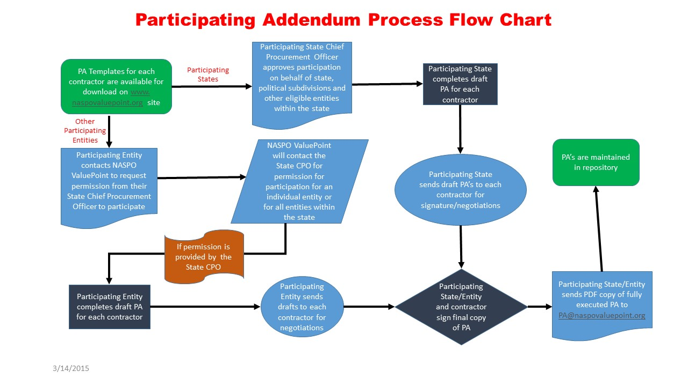
PA Process Flow Chart

Slide 24
State Executed vs Polysub
Executed PA’s
If a state has executed a Participating Addendum that allows for Political Subdivision’s to conduct purchases, NASPO ValuePoint discourages individual entities and contractors from executing a separate or additional Participating Addendum.
If a Political Subdivision needs to execute a separate contractual document, that contractual document should be maintained at the political subdivision level. Do not forward to NASPO ValuePoint

Slide 25
Things to Remember
Sample PA’s are located on the NASPO ValuePoint Website under each master agreement portfolio.
Executed Participating Addendum will be maintained on www.naspovaluepoint.org and in a repository.
Participating states and entities will be identified on the map of the USA on each Master Agreement page on www.naspovaluepoint.org
The Lead State and NASPO ValuePoint do not get involved with negotiations.
Only submit completed and negotiated PA’s with signatures from both parties.
Submit completed PA’s in PDF Format.
Notes:
25

Slide 26
Please let NASPO ValuePoint know if we can be of any assistance:
Shannon Berry, NASPO ValuePoint Cooperative Development Coordinator
sberry@NASPOValuePoint.org (775) 720-3404
* NASPO ValuePoint Point of Contact for these Master Agreements.
Notes:
26

Slide 27
Thank You!

