Slide 1
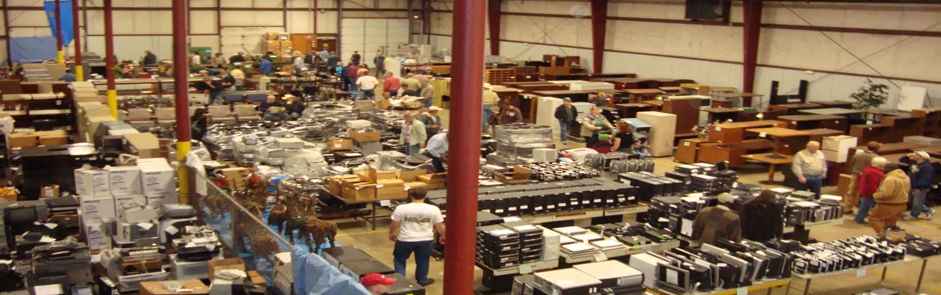
How to Dispose of State Property through M&R

Slide 2
Getting Started
Step 1. The SDF web site is user ID and password protected. Contact M&R (501-565-8645) to request a user id and password. Each agency person accessing and completing the SDF must have prior authorization through Marketing and Redistribution.
Step 2. The SDF is required to delete assets from agency’s fixed asset inventory. The SDF is completed by an agency manager to turn in excess, obsolete assets and other surplus property to Marketing and Redistribution (M&R) for disposal.
https://www.ark.org/eforms/sdf_admin/admin.php
This web based form allows a state agency to create a list of items to be disposed through Marketing and Redistribution.
Using the form, an Agency may request one of the following actions:
  delivery (agency will deliver the property to M & R)
  pick-up (M & R will arrive at the agency’s location to remove the property)
Notes:
The Surplus Disposal Form (SDF) is completed by an agency manager to turn in excess, obsolete assets and other surplus property to Marketing and Redistribution (M&R) for disposal. The SDF is the first step required to delete assets from agency’s fixed asset inventory.
Each agency person accessing and completing the SDF must have prior authorization through Marketing and Redistribution. Agency property manager must contact M & R requesting a user name and password.

Slide 3
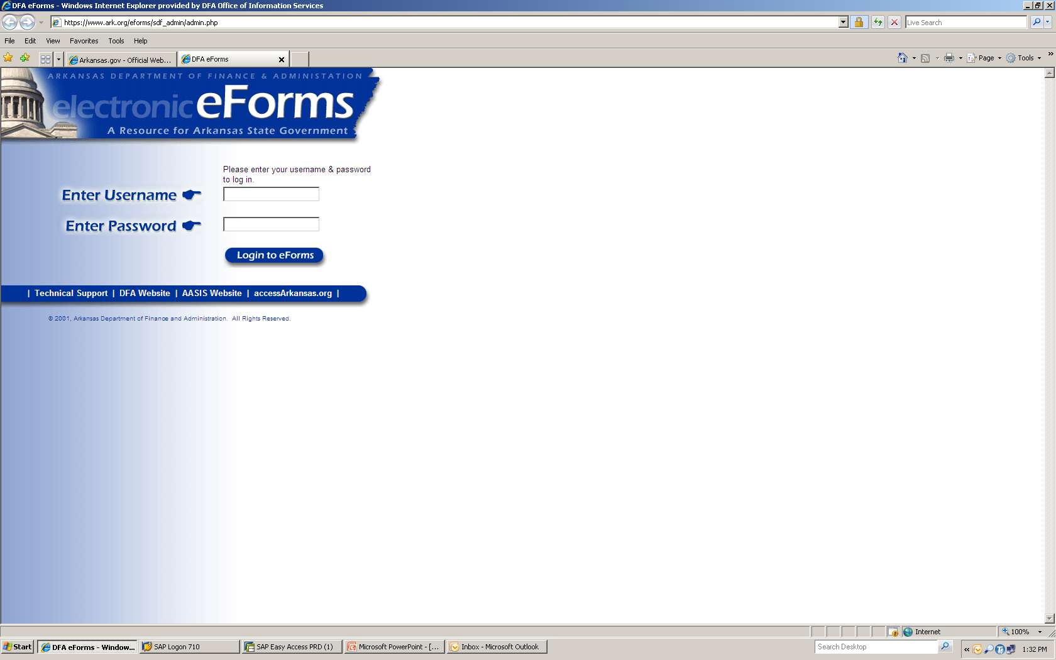
The following screen will appear when the web is accessed.
Notes:
The above screen will appear when the web is accessed.

Slide 4
The following screen will appear when the correct username and password has been entered:
Click on the mouse icon to open the “Surplus Disposal Form” application.

Slide 5
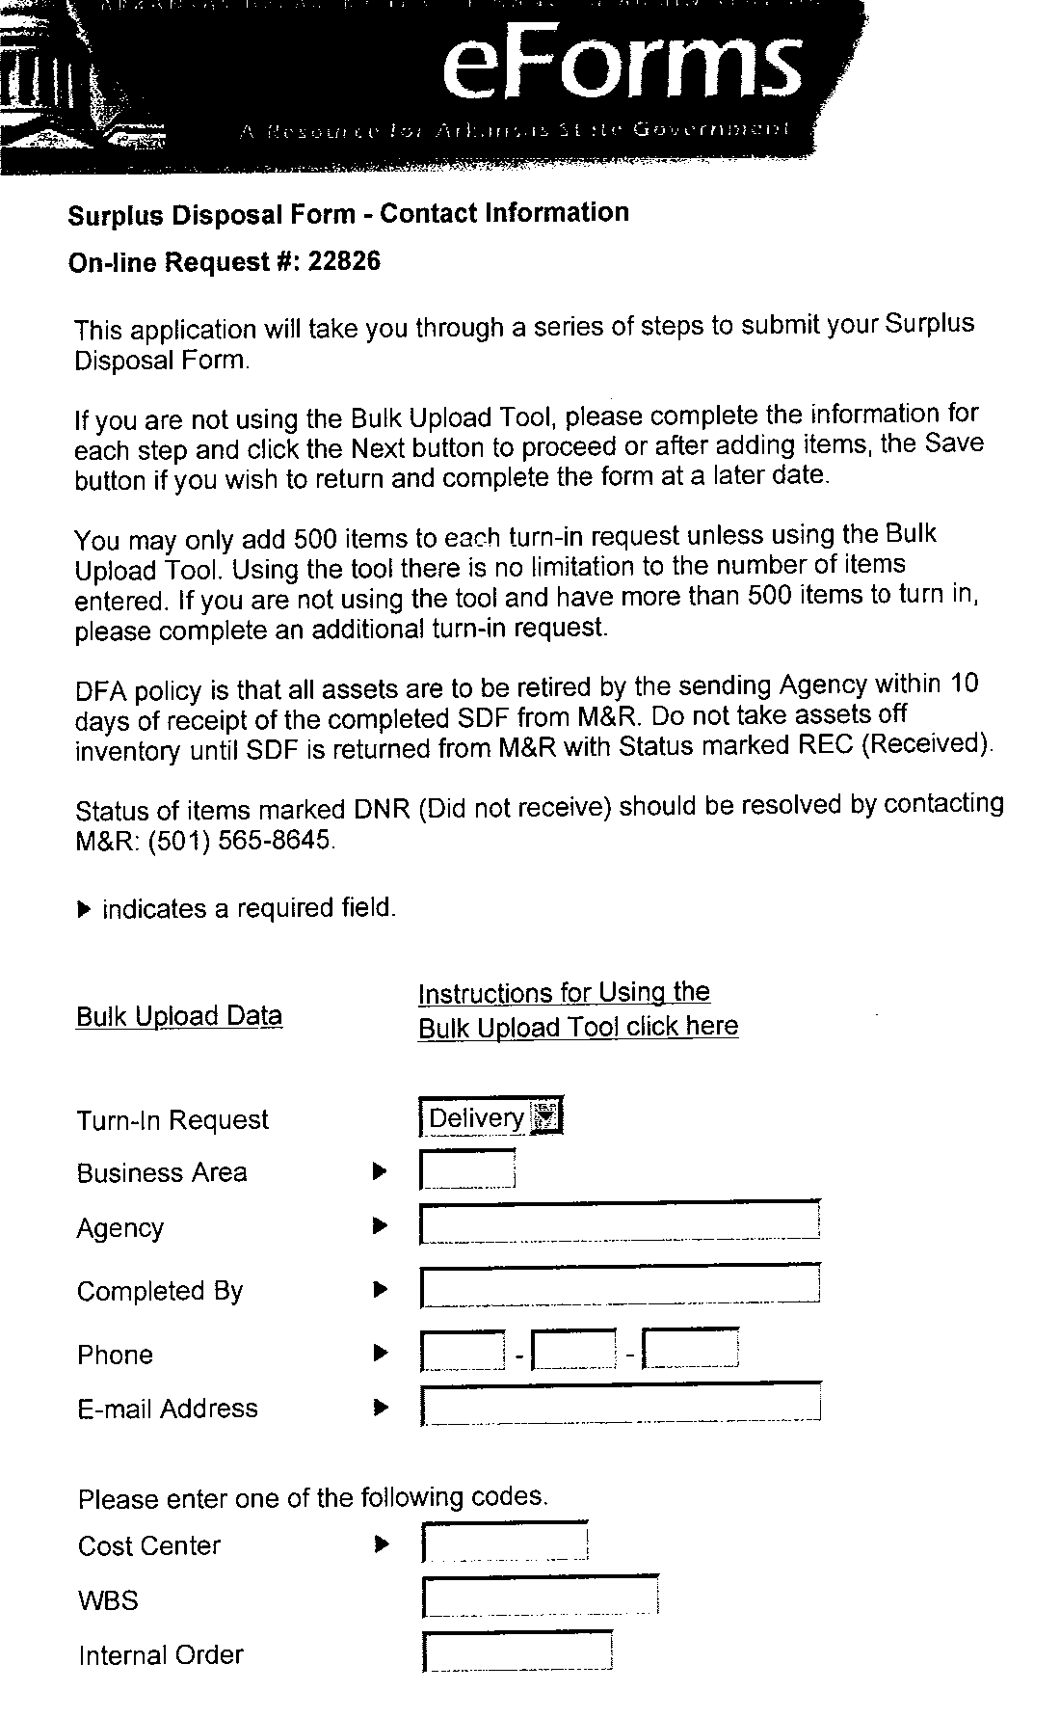
Notice the number of your request at the top left of the page. Jot this number down for future reference.
Notes:
Once you have entered the “Surplus Disposal Form” application you will go through a series of steps to submit your request. First you will notice the number of your request at the top left of the page. Next you will enter the information for each step and click “Next” button to proceed.
The following is a screen shot of how each step will display during the process.

Slide 6
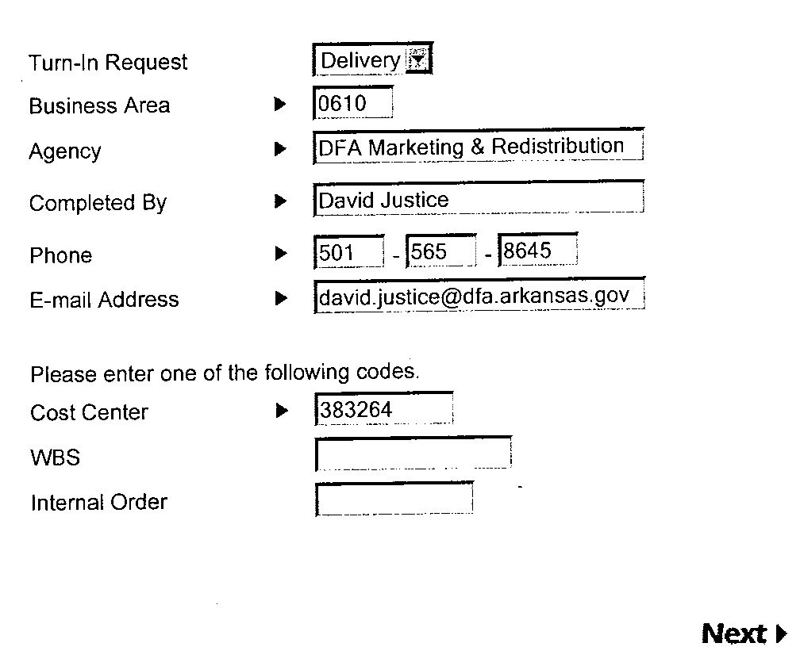
Next you will enter the information for each category field.
Note: The arrows indicate required fields.
A separate SDF must be entered when different cost centers are used and when turning in Vehicles.
Click NEXT to continue.
Notes:
Note: the arrow indicates required fields.

Slide 7
The next screen will allow you to enter information for each item, then click “Add” for each single item to be turned in.
If an item has an asset number, property number or serial number you may only enter a quantity of one.
If there are multiple like items, you may enter the number count in the quantity and the system will automatically separate to single line items.
After you have entered all surplus items, you will click “Next.”

Slide 8
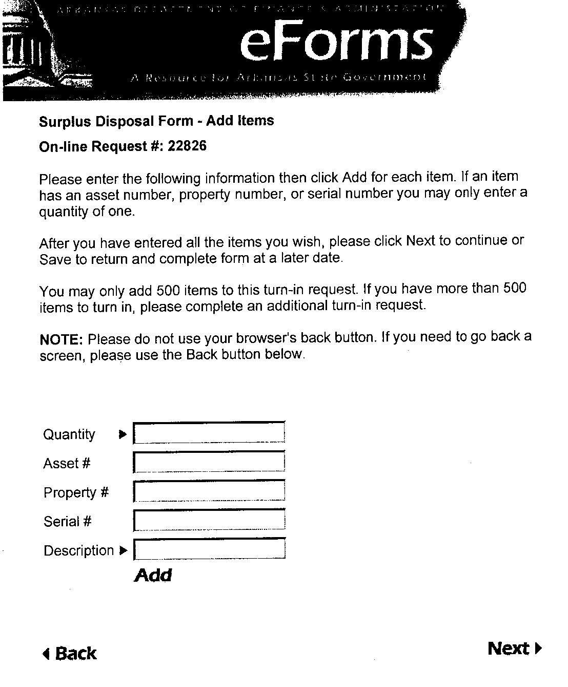
This application will take you through a series of steps to submit your Surplus Disposal Form. You will complete the information for each category.
Click Next when finished entering ALL items!!

Slide 9
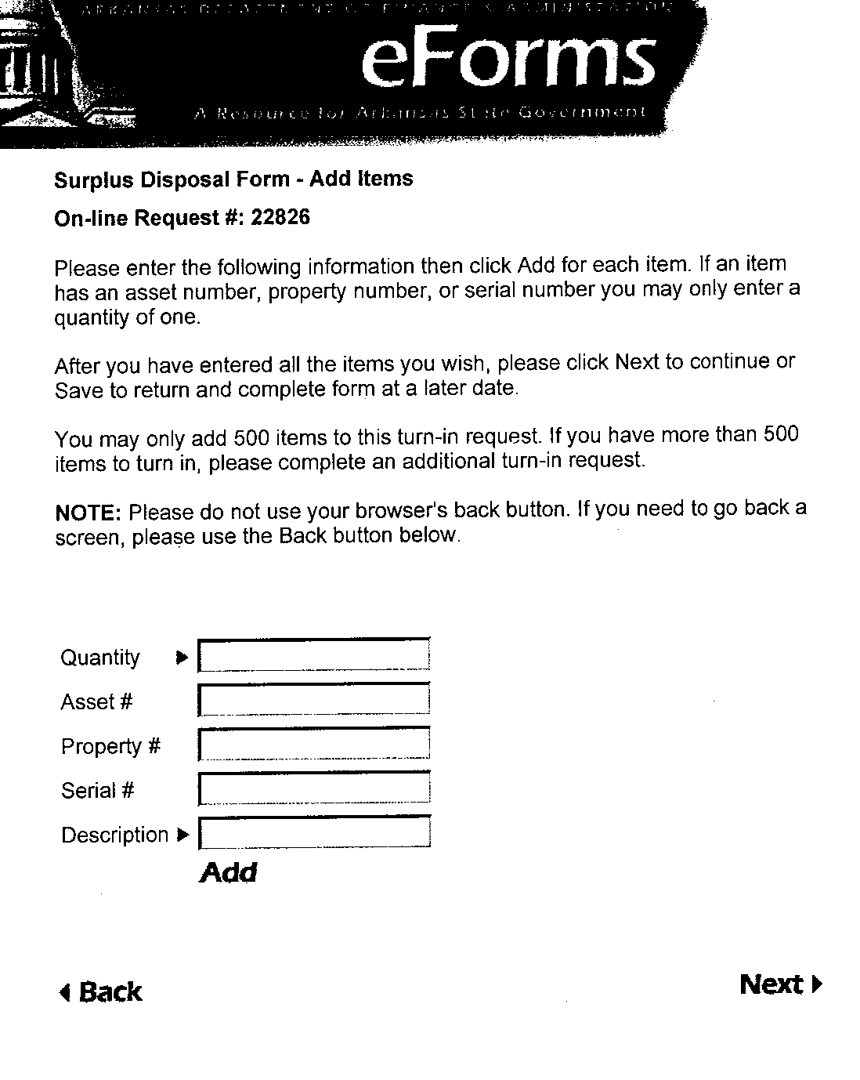
This is a screen shot that will appear each time an item is entered when you click “Add” to continue.

Slide 10
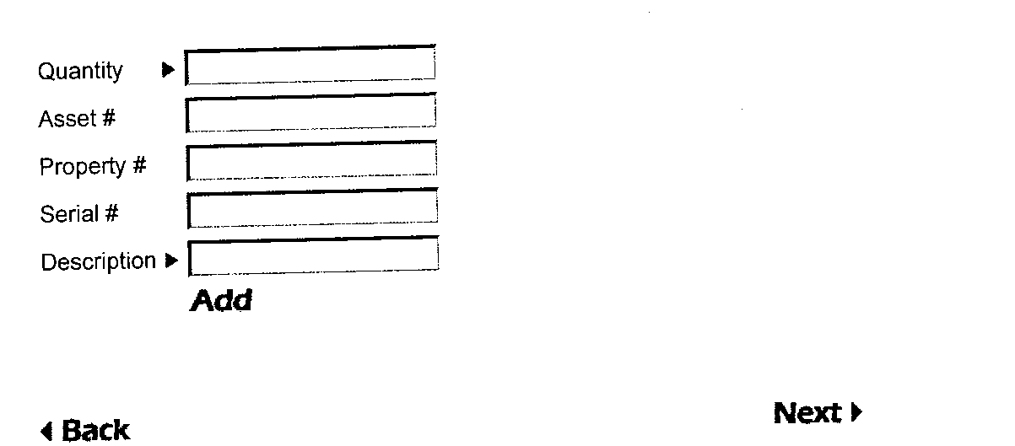
Quantity: “Required” Enter the quantity of the material.
Asset #: “Semi Optional” Enter the AASIS assigned number.
Property #: “Semi Optional” Enter the agency tag number assigned
Serial #: “Optional” Enter the serial number if applicable
Description: “Required” Enter a description of the item. 40 Characters
Click “Add” to continue.

Slide 11
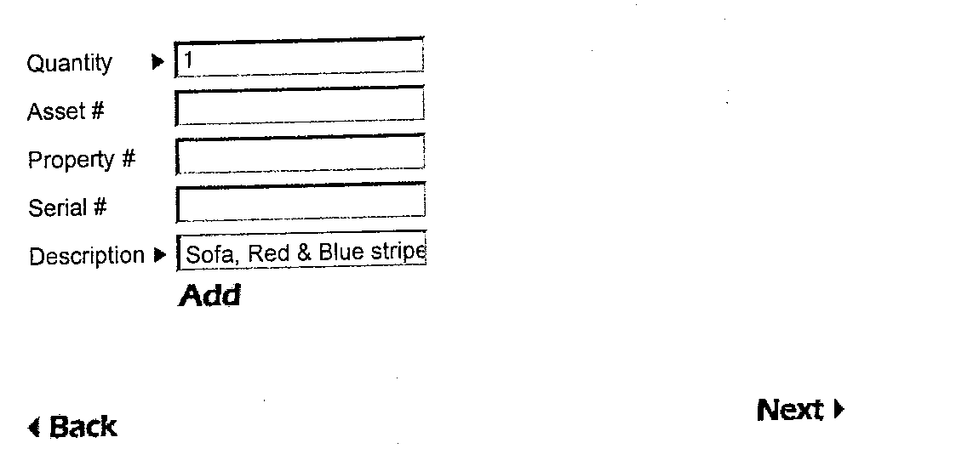
In this example you will see I have entered one (1) in the quantity field and described the item.
Click “Add” to continue.

Slide 12
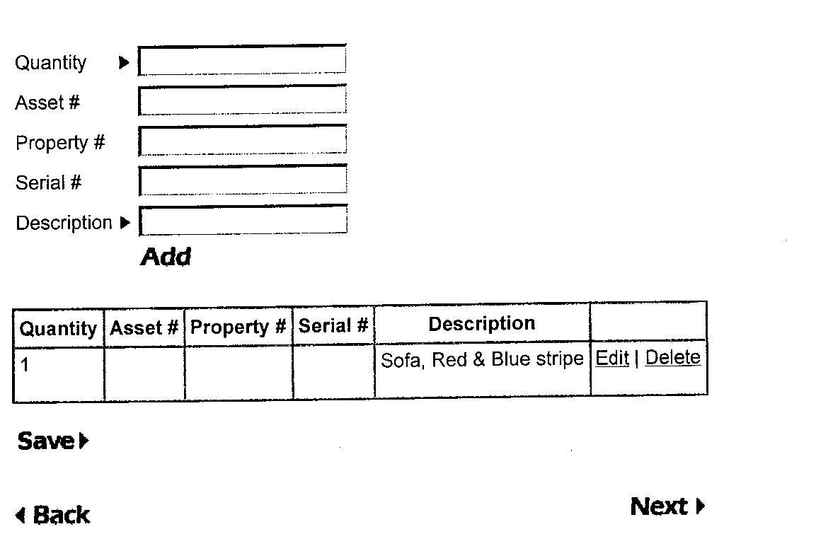
The item has been entered to the SDF with a quantity of one (1) giving the option to add more items.
Once the first item is added to the SDF, note “Save”. From this point forward you have the ability to save the SDF to return at a later time.

Slide 13
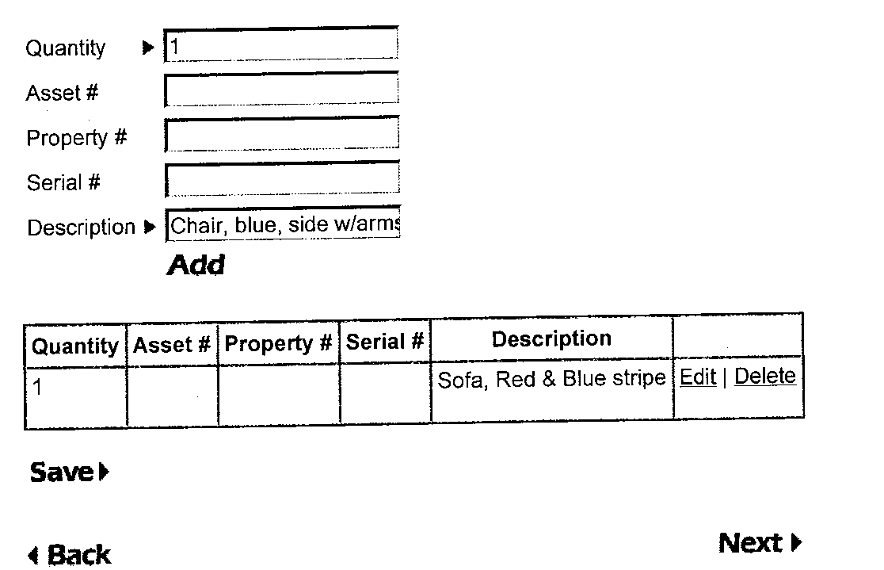
In this example one (1) was entered again in the quantity field with a different description.
Click “Add” to continue.
Notes:
Note: now you can see the last item you have entered.

Slide 14
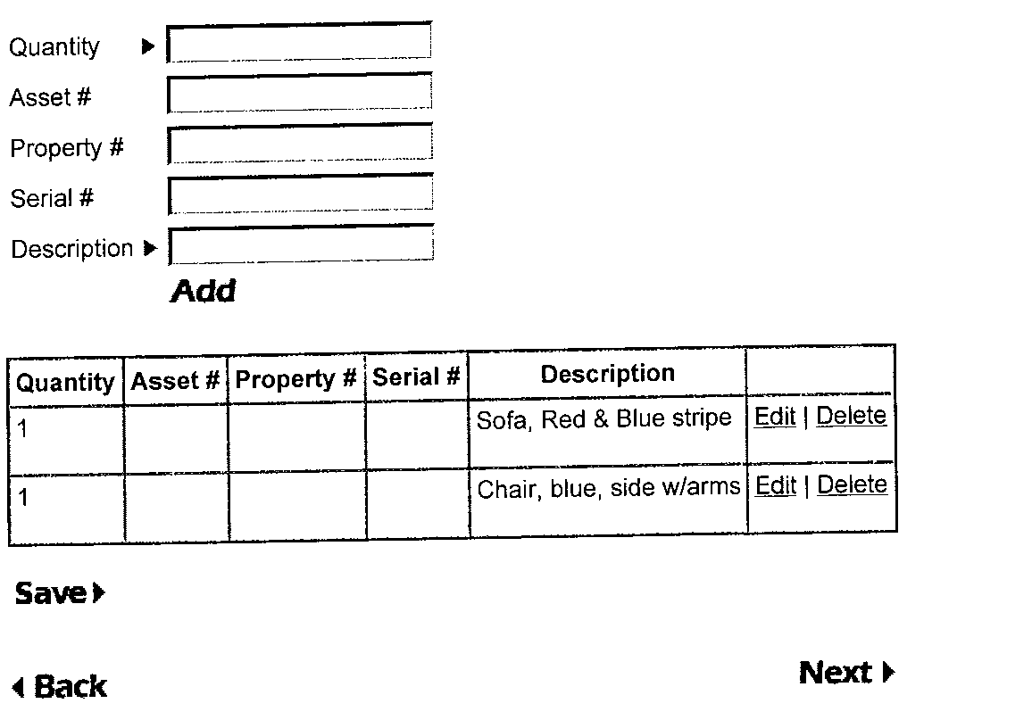
The blue chair has been added as the next line item on the SDF along with the Sofa.

Slide 15
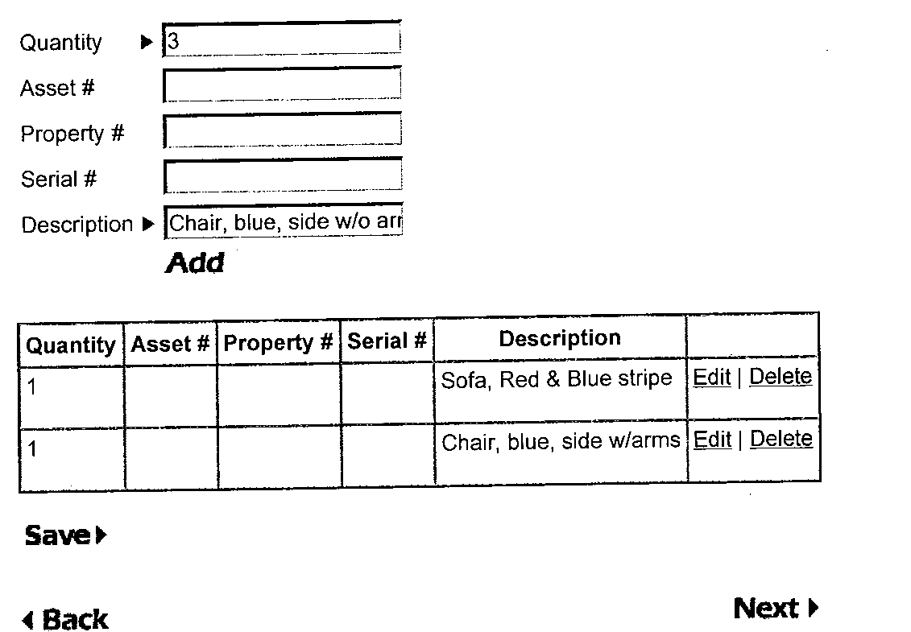
In this example I have entered three (3) in the quantity field and described the item.
Click “Add” to continue.

Slide 16
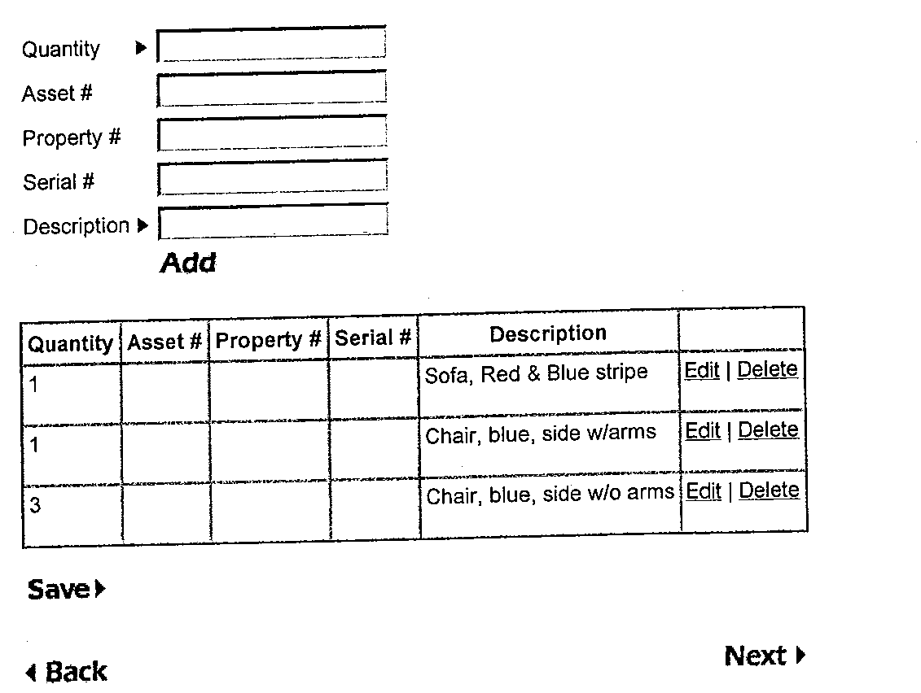
You will note that it has placed 3 in the quantity. As we move forward it will make three separate line items.

Slide 17
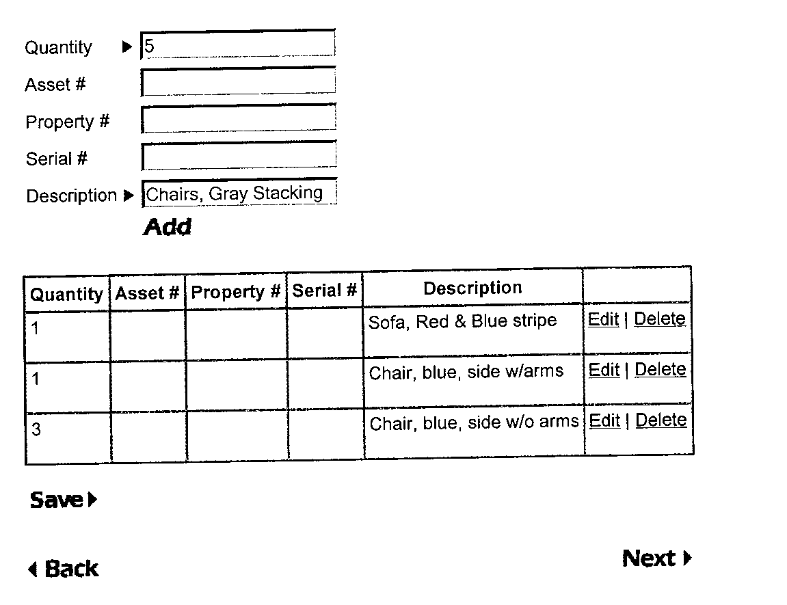
Again we have entered a multiple quantity using the same description. Then we click “Add” to continue.

Slide 18
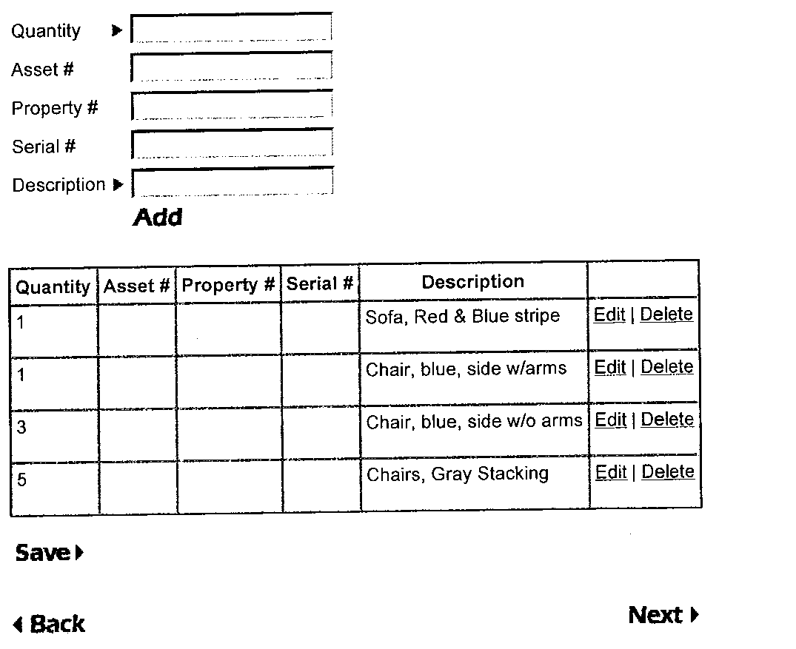
This entry is like the previous one with multiples in the quantity.

Slide 19
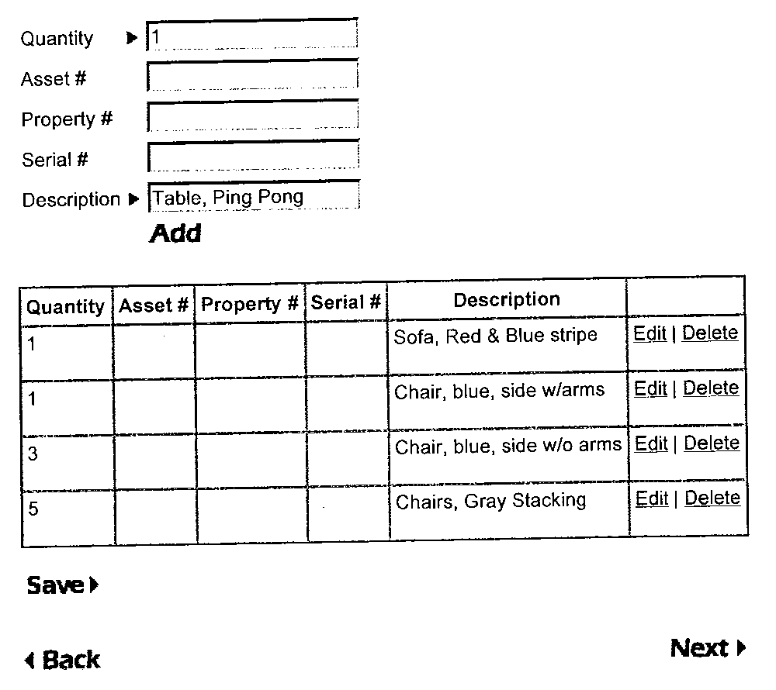
In this example I have entered one (1) in the quantity field and described the item.
Click “Add” to continue.

Slide 20
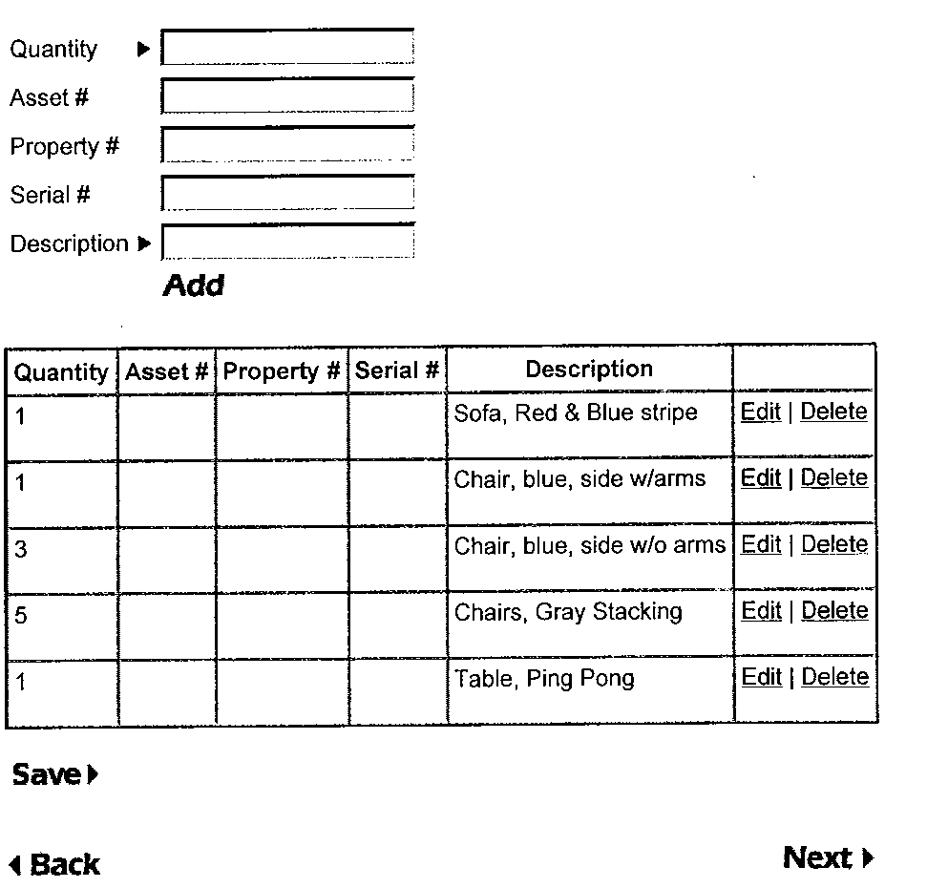
At this point we have entered eleven (11) pieces of property using five (5) lines.

Slide 21
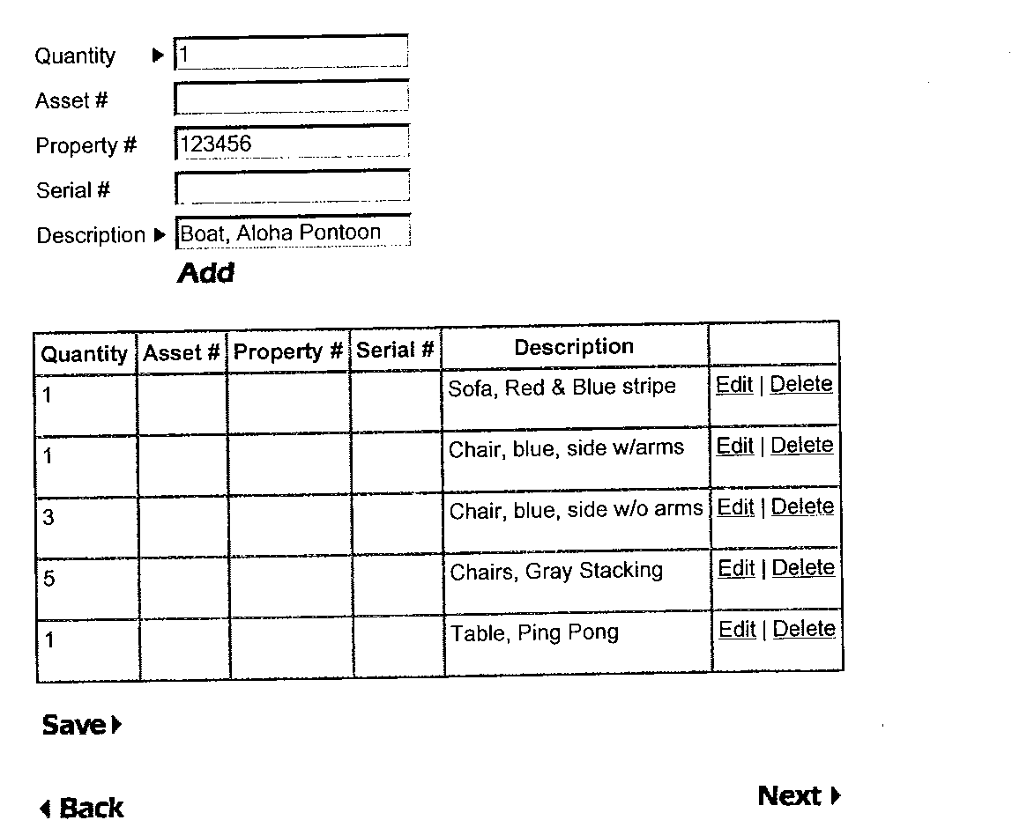
In this example we will add a property number and asset number. Click “Add” to continue.

Slide 22
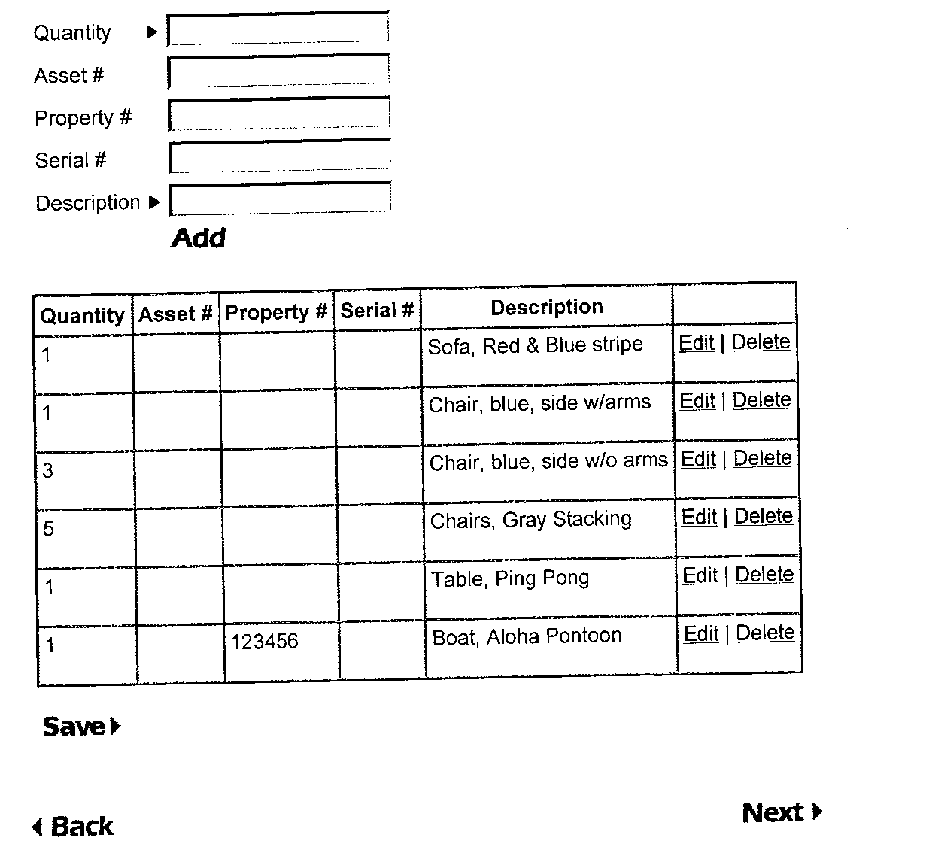
I failed to enter the asset number for the last entry!
Click “Edit” to make changes.

Slide 23
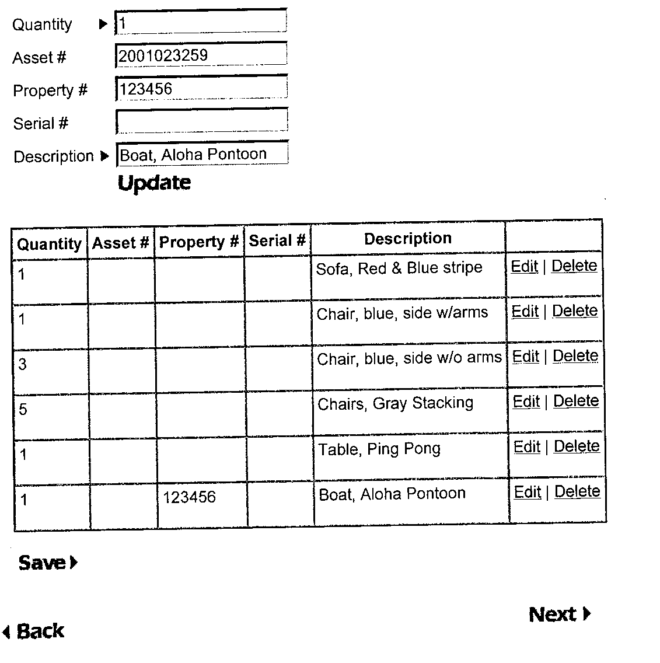
I have gone back to my previous entry to make the necessary correction. (Adding the asset number)
Next click “Update” to continue.

Slide 24
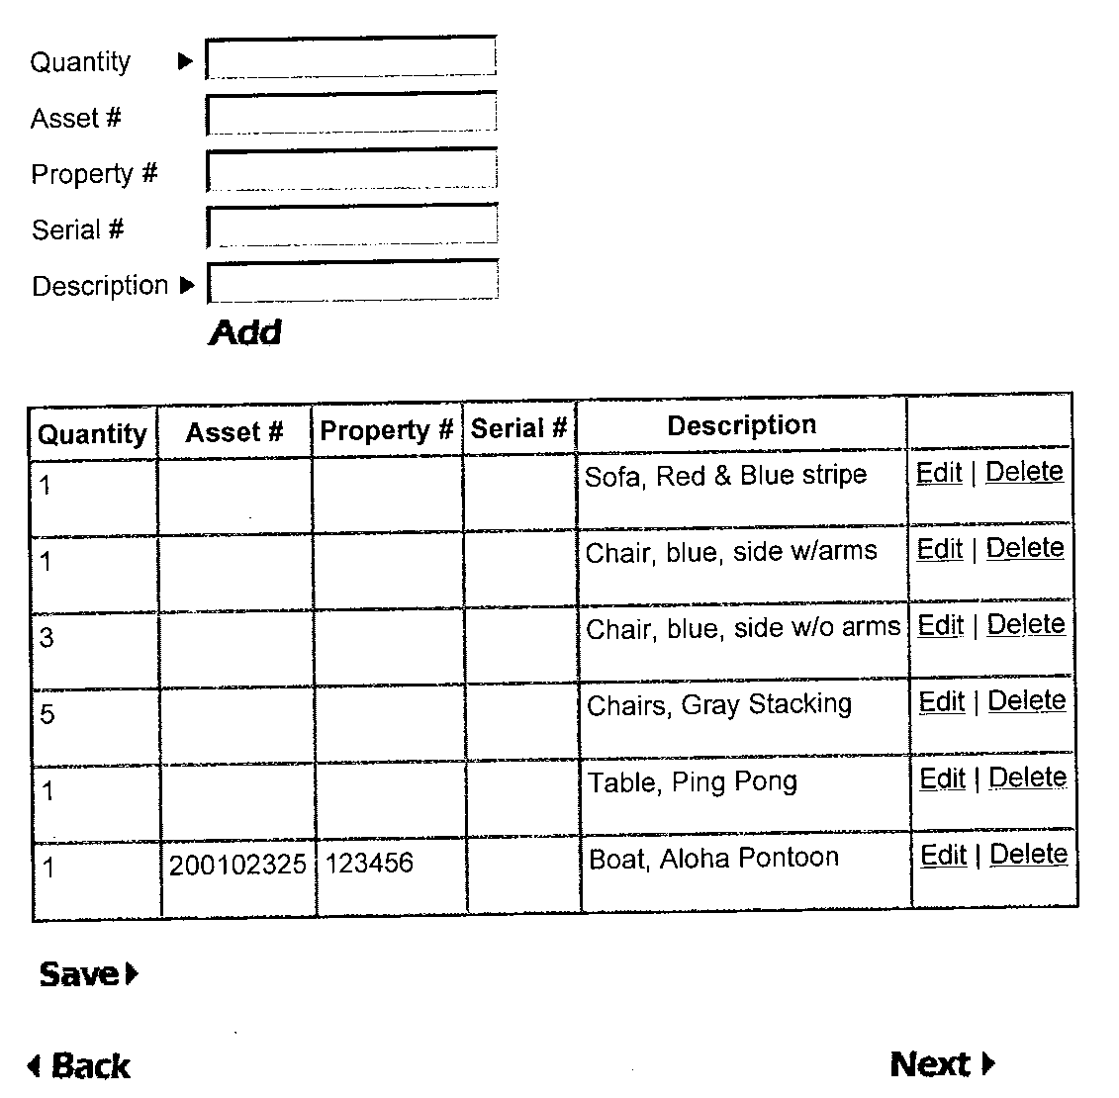
Now the Asset Number has been added to the SDF and we are ready to complete the process.
Click “NEXT” to continue.

Slide 25
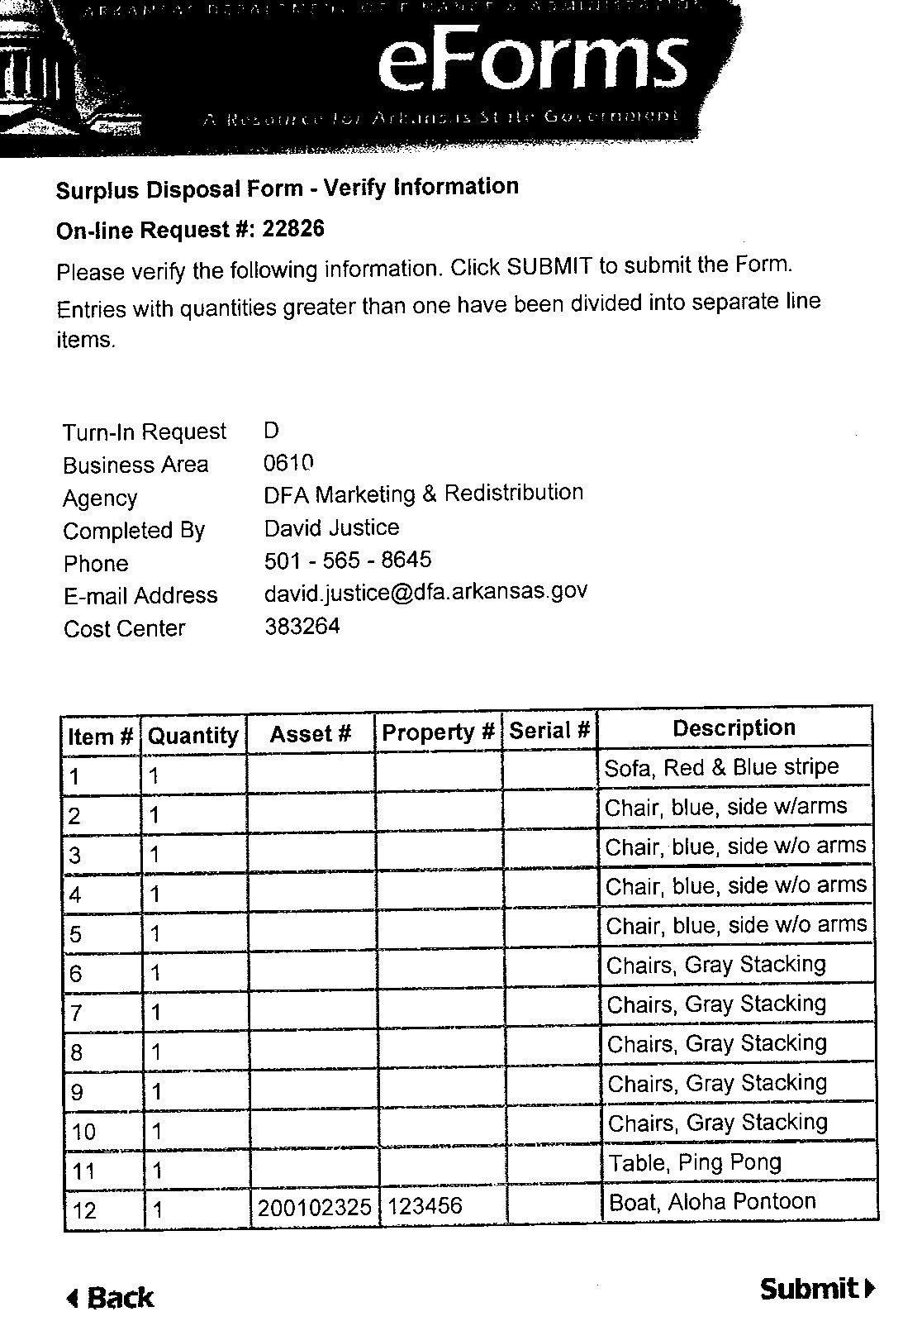
This is the last step and final opportunity to make any corrections before the SDF is submitted to M&R.
Notice the multiple quantities were automatically separated to single line items. Click “Submit.”

Slide 26
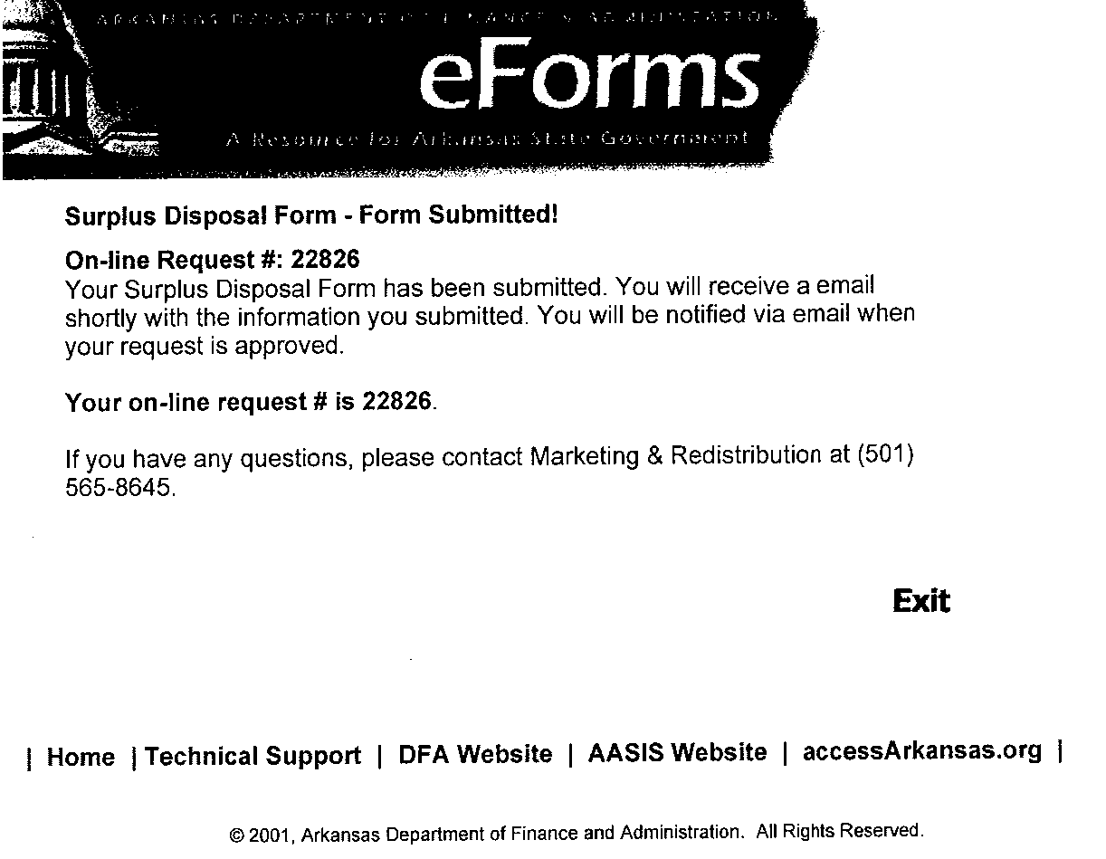
Once you have submitted your request you will receive confirmation that the form was successfully submitted.
Click “Exit” to leave the form.

Slide 27
Email Message Sender will Receive upon submission
A copy of the SDF Request form you just submitted is attached. M&R will contact your agency via email with the date and time of the delivery or pick-up or approval of an on-site sale.
If you have any questions, please contact M&R at (501) 565-8645

Slide 28
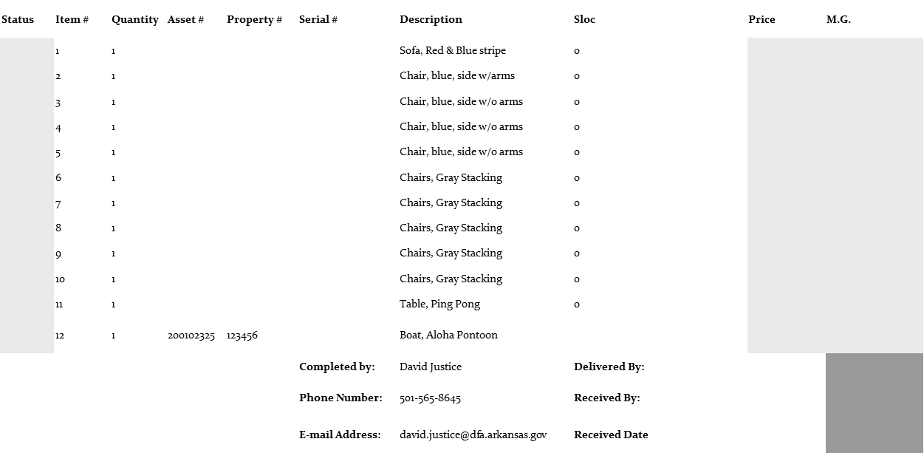
Once M&R has received the property that is to be turned in, the SDF is completed by M&R and submitted to AASIS to have the items entered into M&R’s inventory.

Slide 29
When the SDF is submitted to AASIS by M&R, the server will automatically e-mail a completed SDF to the email address listed on the SDF. The completed SDF will be annotated with “REC” (received) or “DNR” (did not receive) in the status column. Below is a copy of the automatic email.
The completed SDF Request # ????? is attached. Please review the completed form and contact M&R immediately if you feel there is an error.
If you have any questions, please contact M&R at (501)565-8645. Note: Policy is that all assets are to be retired within 10 days of receiving this completed SDF from M&R.

Slide 30
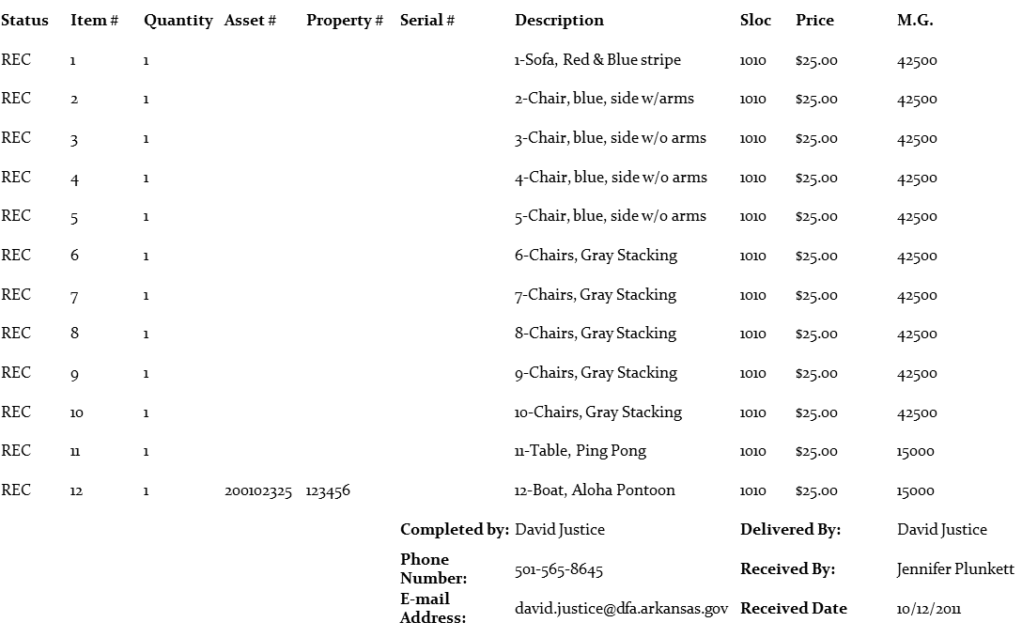
Upon receipt of the completed SDF the Agency Asset Manager will need to complete AASIS Transaction ABAVN – to delete the asset from the agency’s fixed asset inventory.
Below is a copy of the completed SDF with each line item status marked “Rec”.

Slide 31
Certificate of Property Disposal (CPD)
The CPD is processed in the same manner as the SDF. When approved, this authorizes the agency to dispose of the property listed at their location. Currently there are five (5) categories for proper disposal.
(A) Cannibalization
(B) Destruction
(C) Scrap Metal Sale
(D) Negotiated Sale (3 Quote)
(E) E-waste Recycle

Slide 32
Trade-In and Donation of Surplus Property
Surplus property may be traded in when the value is expected to exceed the estimated value to be obtained through the sale less expenses incurred during a sale.
Certain property may be donated.
Written request must be submitted identifying the equipment by name, serial and property number, etc. to the Marketing and Redistribution Manager.
Donation requests are evaluated and forwarded to the Procurement Administrator for determination.

Slide 33
Live Call Auction
The state currently has an auction company on contract. Arrangement can be made through M&R to have the Auctioneer come to your location to sell surplus property.

Slide 34

Questions!

Slide 35

Govdeals link and E-News sign up

Slide 36
Vehicles

Slide 37

If a vehicle is being pulled from service, don’t park it until you have approval and money to replace it, TURN IT IN TO M & R. The agency will not lose that vehicle slot and has two years to fill.
Please turn in two ignition keys for each vehicle.
Please do not sign the front or back of titles
Notes:
Do not sign the front or back of titles.

Slide 38
In the event of an accident, contact the insurance company so a damage evaluation can be made on the vehicle. If the vehicle is a Total Loss, contact M & R for instructions.
If the vehicle needs to be towed, ask for it to be taken to the nearest State owned property or delivered to M & R
Notes:
If the vehicle need to be towed ask for it to be taken to the nearest State owned property or delivered to M & R.

Slide 39
