Slide 1
Procurement Forum
March 14, 2013

Slide 2

Creative
Ways
To Meet
Your Minority
Business
Goals

Slide 3

Know the minority status of your current and potential vendors:
Vendor Information Request Form
Vendors are required to fill one out before a
purchase order is issued.
This helps to determine the status of the
vendor as a minority and to track expenditures.
You may already be utilizing vendors that just
have not been properly identified.
The form could be modified to fit your
particular needs.

Slide 4
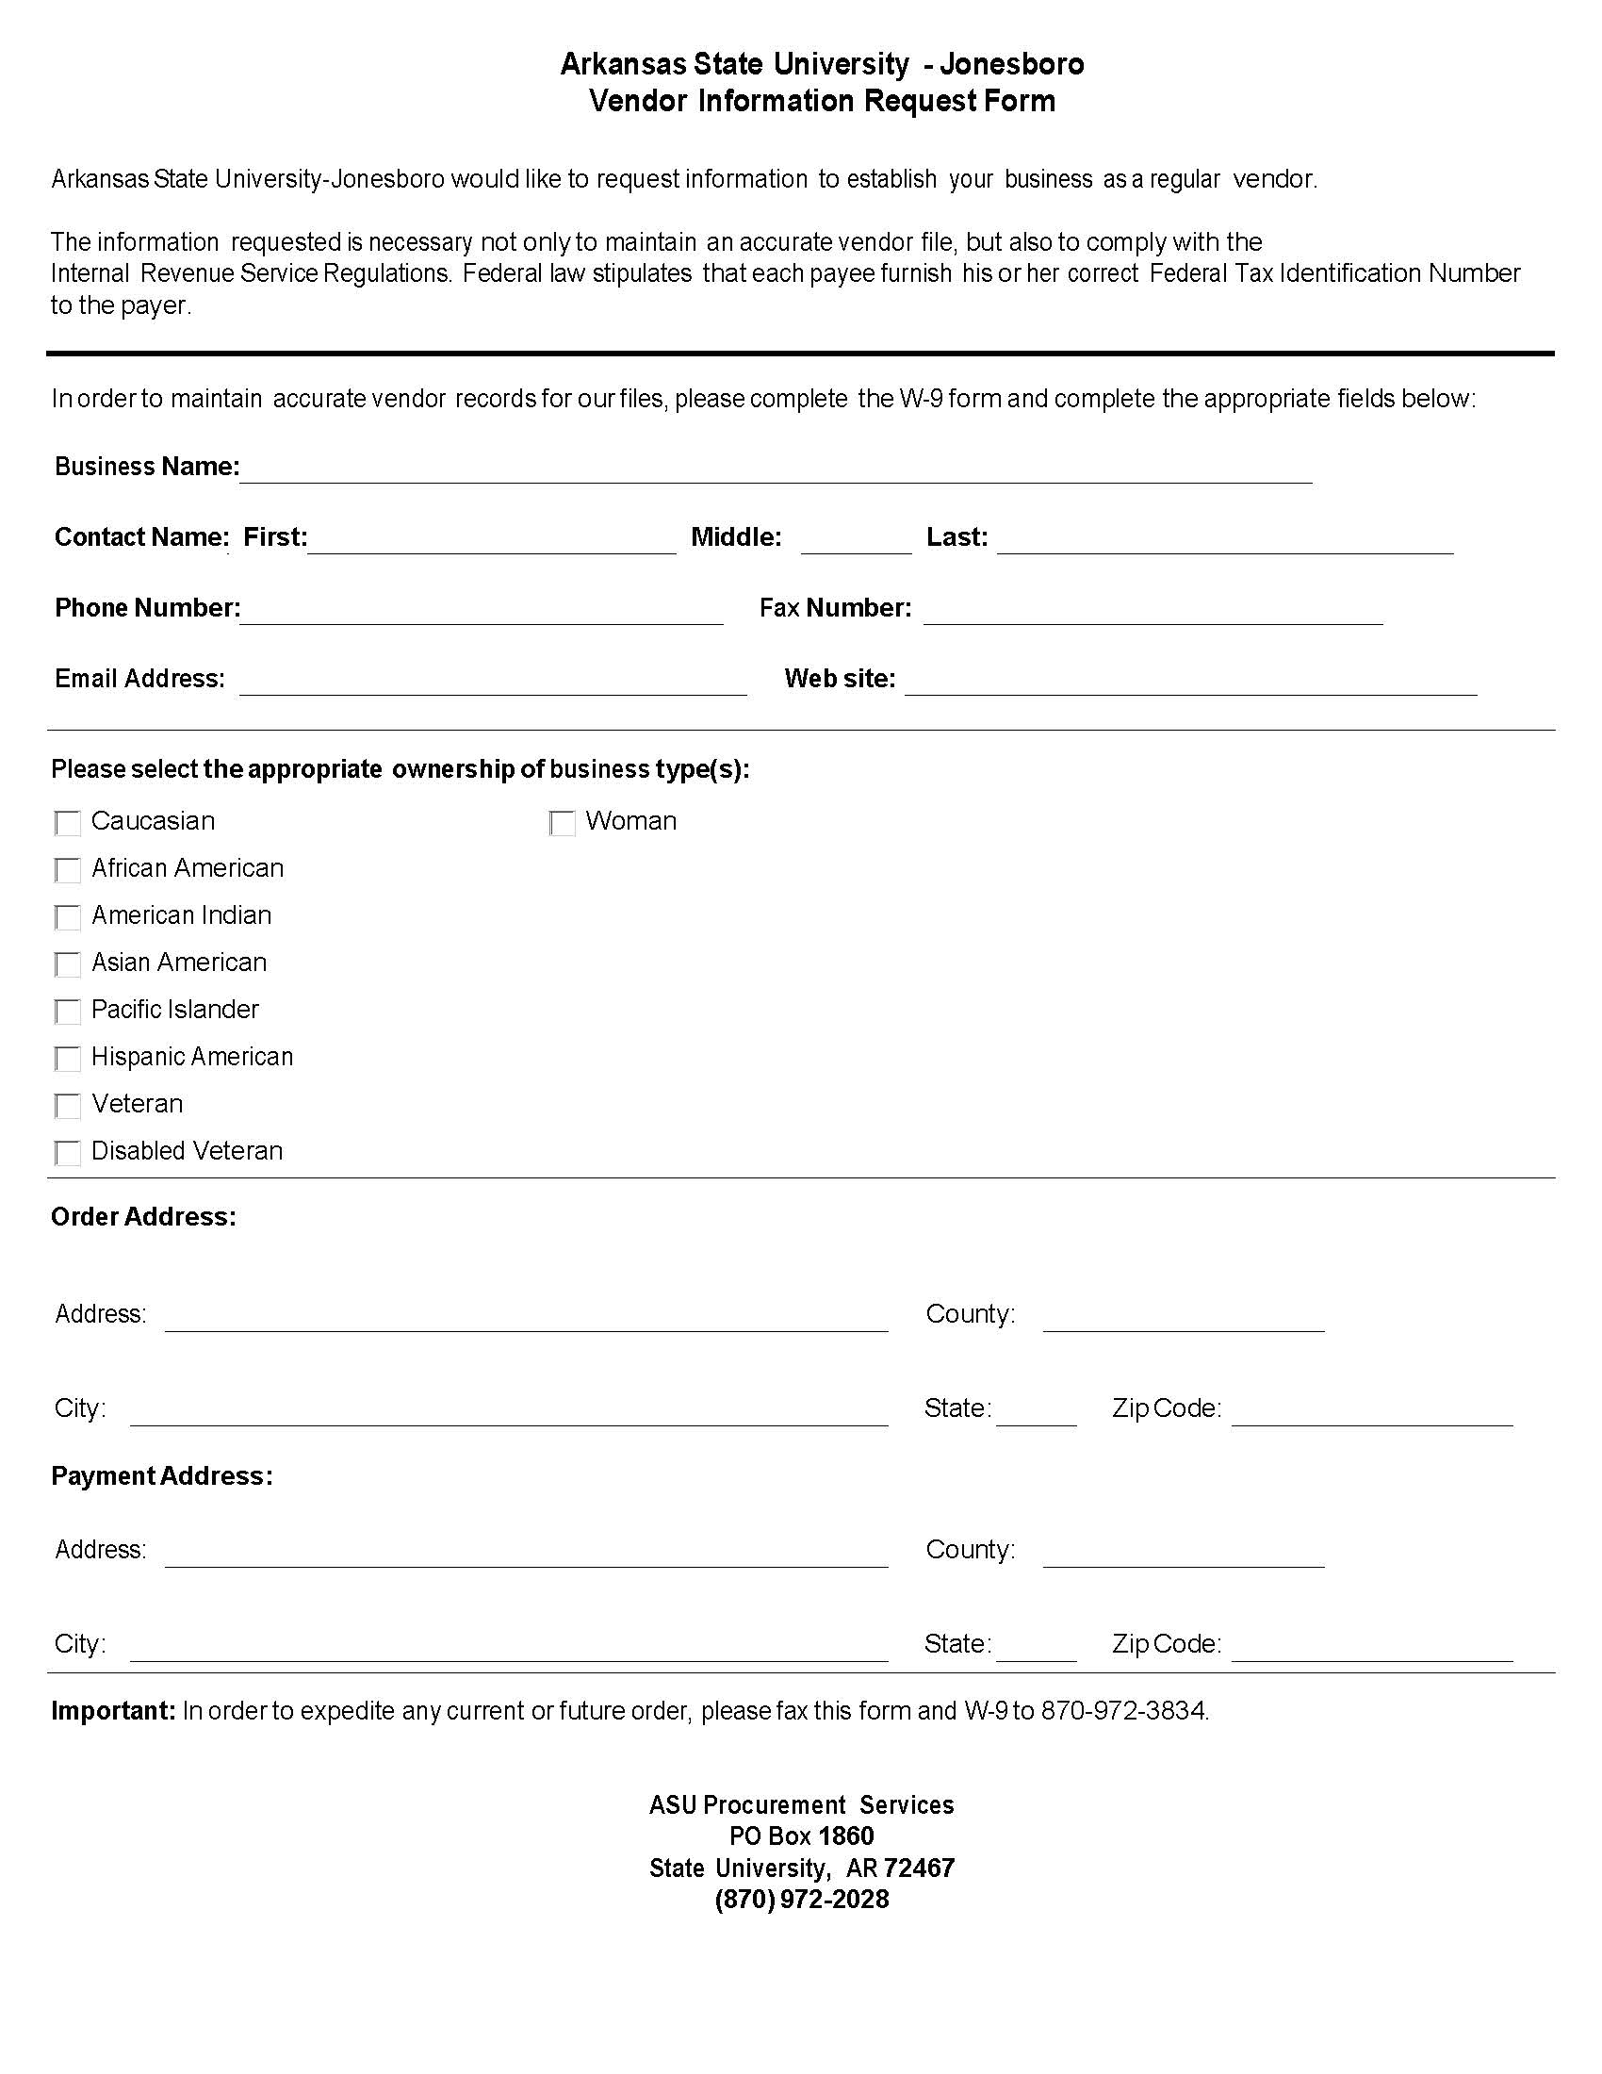

Slide 5

Further identification of minority purchases:
Review Thoroughly
Review all requisitions that are processed and attempt to identify any potential minority expenditure that may have been missed.
An unidentified vendor may have an ethnic or
foreign sounding name, such as an Asian
or Hispanic surname that can be contacted
to determine their status.
Look for all types of services that you
might not have thought of to capture
such as speakers, referees, musical
entertainers, etc.

Slide 6

Identification of Sub-contractors for Construction
General Contractors, Architects, Engineers, etc.
General Contractors, Architects, Engineers, etc. whose services
have been retained may be required to fill out a similar
Minority Vendor Report for
construction.
This report may be filled out quarterly
for inclusion on a quarterly vendor
expenditure report.

Slide 7
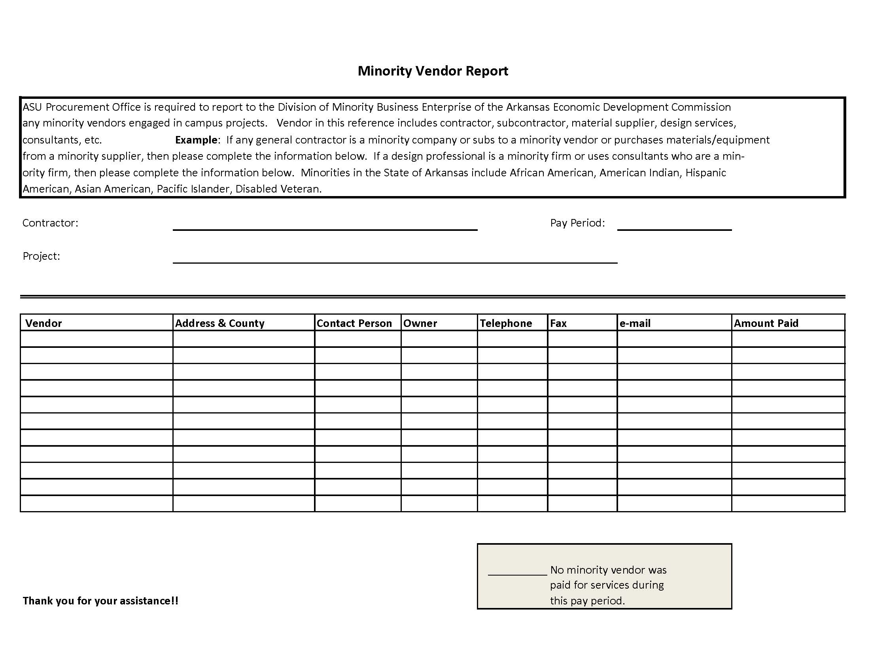

Slide 8

Community Resources
Local Area Chamber of Commerce
Employer Expos
Hispanic Community Services
Local Magazines
Other Buyers in
the Community

Slide 9

Professional Organizations
Professional organizations offer networking opportunities with your peers as well as educational opportunities to enhance your professional development. Find out what your counterparts are doing to develop and enhance their Minority Purchasing Programs. Two groups widely represented in
Arkansas are:
NIGP:
The National Institute of Governmental Purchasing-Arkansas Chapter
http://www.arnigp.org
NAPM-Arkansas
National Association of Purchasing Managers, now Institute of Supply
Management (ISM)
http://www.ism.ws/sites/arkansas/index.htm

Slide 10

State Directories
Arkansas Unified Disadvantaged Business Enterprise Directory:
http://www.arkansashighways.com/ProgCon/letting/dbedirectory.pdf
Arkansas Economic Development Commission:
http://www.arkansasedc.com/small-and-minority-business/small-and-minority-business-directory.aspx

Slide 11
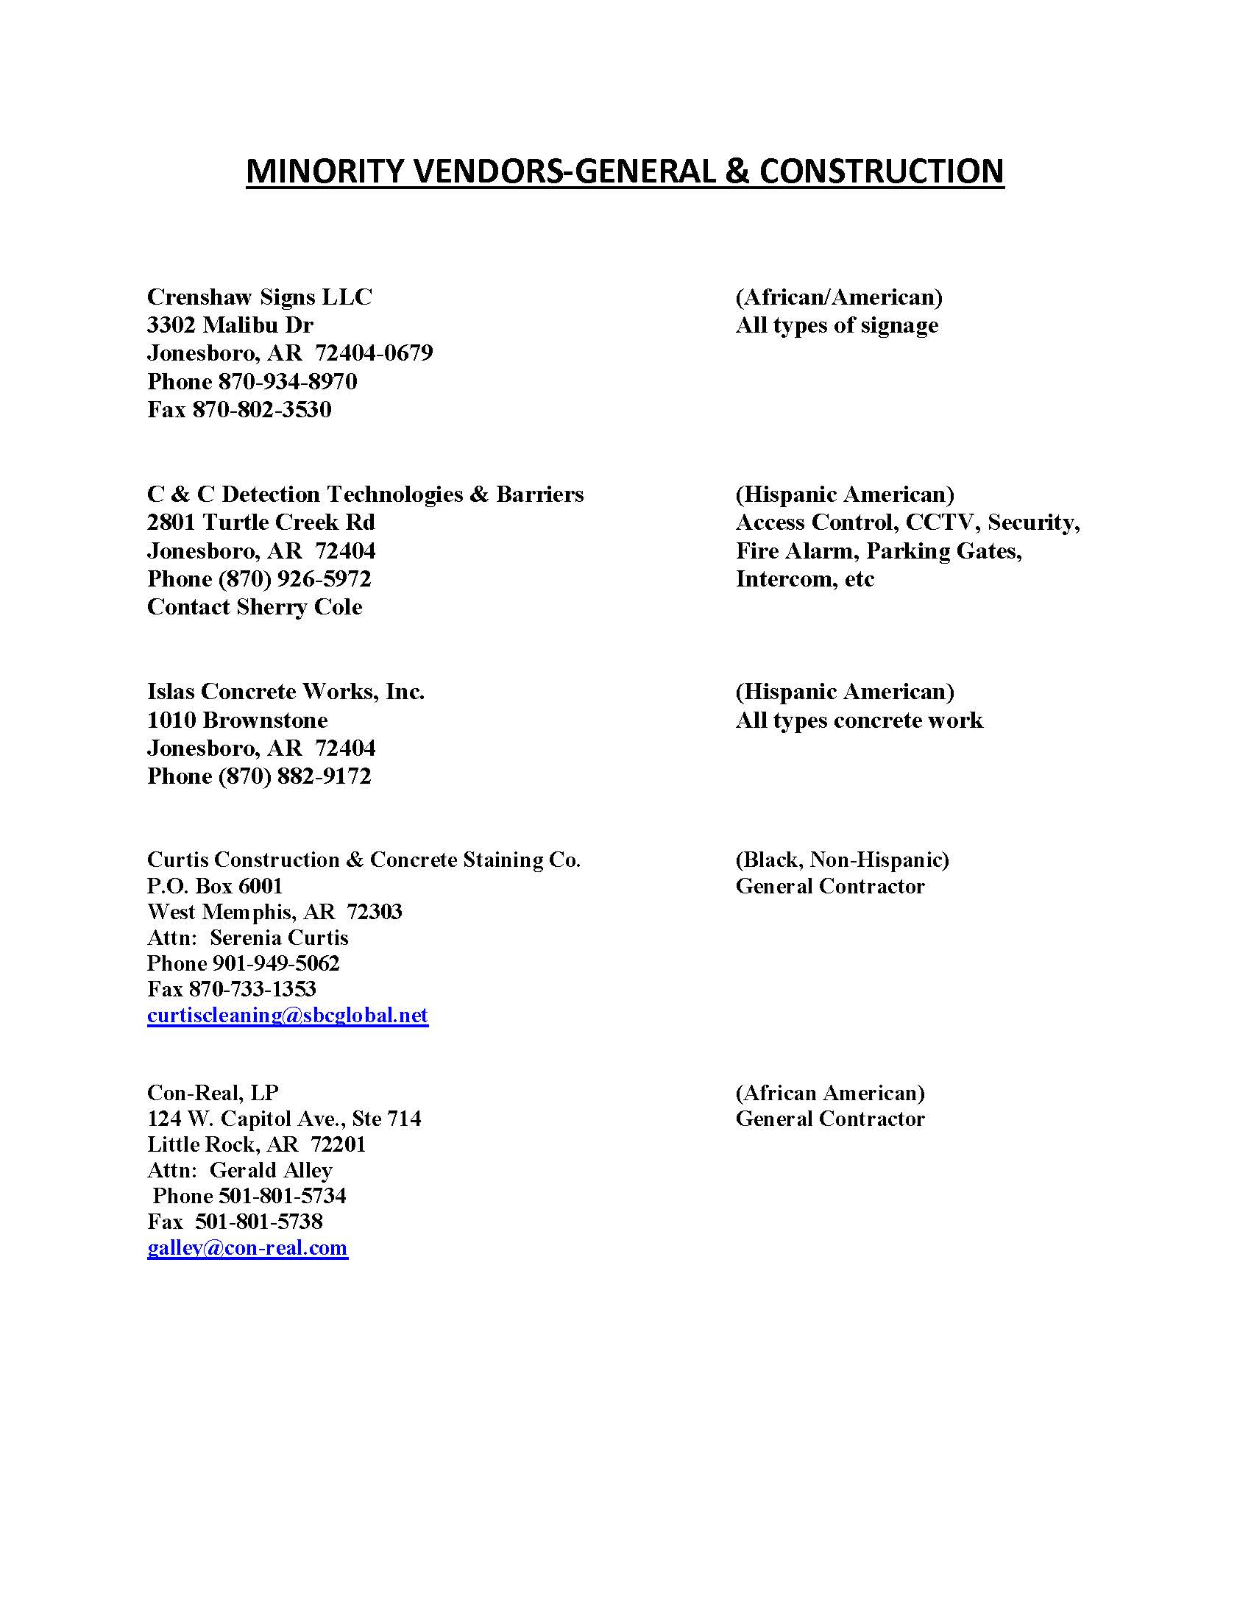

Slide 12
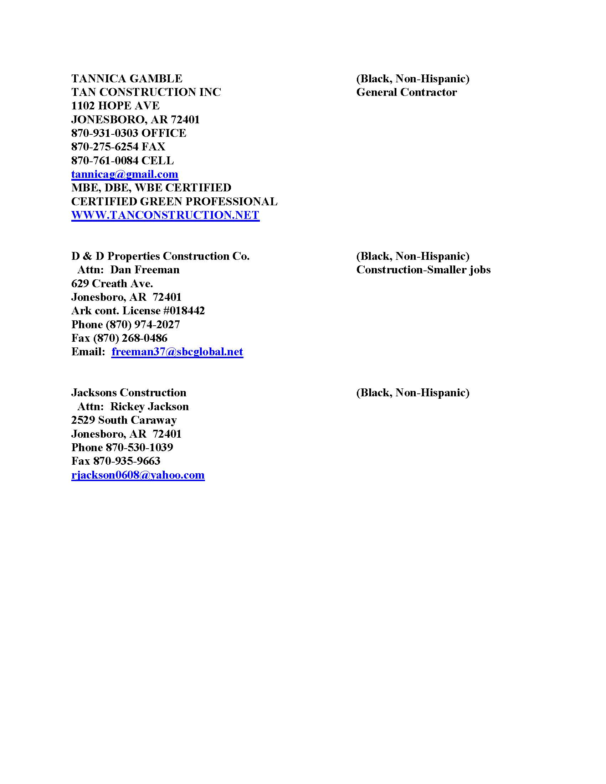

Slide 13

QUESTIONS
Lola Langley, C.P.M., CPPO
Arkansas State University-Jonesboro
llangley@astate.edu
870-972-2028
Doris Rush
Department of Workforce Services
Doris.Rush@arkansas.gov
501-682-3731

Slide 14
Arkansas Procurement Assistance Center
Office of State Procurement
Monthly Forum
March 14, 2013
Notes:
While this title page is displayed, welcome everyone, get them settled, circulate the attendance list and explain its purpose, and distribute a handout copy of these slides if it is being used.

Slide 15
What is APAC?
“The Arkansas Procurement Assistance Center, which serves as a Procurement Technical Assistance Center (PTAC), is funded in part through a cooperative agreement from the Department of Defense (DOD) through a program that is administered by the Defense Logistics Agency (DLA). The content of any written materials or verbal communications of the PTAC does not necessarily reflect the official views of or imply endorsement by DOD or DLA.”

Slide 16
APAC Team
David Jerome, Director
Jan Rogers, Administrative Specialist
Nicole Dawson, Administrative Specialist
Delbert Taylor, Program Associate
Ray Blevins, Program Associate
Max Franks, Program Associate
Bobby Hall,
District Coordinator – Delta
Kim Magee,
District Coordinator – Ouachita
Dr. Stacey McCullough,
District Coordinator - Ozark
Notes:
Speaker will handle this no notes needed.

Slide 17

Ray Blevins: Program Associate
United States Air Force Veteran
Senior Level Contracting Officer ,
United States Air Force (civilian).
Small Business Specialist, United States
Air Force (civilian).
Private Consultant, specializing in 8(a),
Service Disabled Veteran Programs,
HubZone, proposal development ,
and registering businesses for
government contract work.
Numerous Contract Management Awards
Level III Certified Acquisition Professional
B.S. Business Administration, University
of South Carolina
M.B.A., Touro University International,
Cyprus, CA.

Slide 18

Max Franks: Program Associate
Over 11 years of Procurement Technical
Assistance Center experience
Over 15 years of experience working with
small businesses (consulting, counseling
and certification)
Over 26 years experience in private sector
management
Past Regional Director, Association of
Procurement Technical Assistance Centers
Member, National Contract Management
Association
Associates Degree, Business and
Accounting, Crowder College, Neosho, MO.
B.A., Business Administration, Missouri
Southern State University, Joplin
Notes:
Introduction

Slide 19

Delbert Taylor: Program Associate
United States Air Force Veteran
APAC Counselor since 2000
Corporate Quality Control Manager
Management and Computer Analyst
at National Center for Toxicological
Research (NCTR)
Lead Systems Analyst at Booz, Allen &
Hamilton
Deputy Director, Project Manager and
Systems Engineer
Bachelor or Science, East Central State
University, Ada, Oklahoma
Commissioned Officer, Officer Training
School, U.S. Air Force

Slide 20
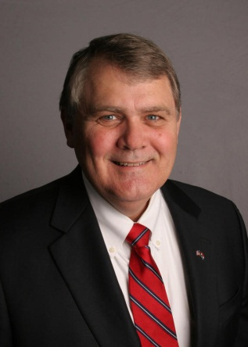
David Jerome: Director
Retired U.S. Army Acquisition
Corps Officer
Certified Level III in both Contract and
Program Management
Contracting Officer (DOD) and Project
Procurement Manager (Industry)
Certified Professional Contract Manager
Graduate, U.S. Army Command and
General Staff College
Graduate, Advanced Program
Management Course
B.S. Business Administration, University
of Central Missouri - Warrensburg
M.B.A., Florida Institute of Technology –
Melbourne
Ph.D., University of Arkansas - Fayetteville

Slide 21
APAC Mission
The purpose of APAC is to assist Arkansas businesses who desire to seek government contracts with federal, state and local agencies and departments.
APAC provides training and counseling to ensure that our clients have the latest and best information available as they pursue their goals.
APAC collaborates with other agencies in order to ensure the overall economic well-being of the State of Arkansas.

Slide 22
What APAC Does For Clients
Help small businesses locate opportunities to sell products and services to public agencies & large primes.
Counseling by professional consultants.
Bid opportunity listings from a large variety of sources.
Technical assistance and instruction.
Access to drawings and specifications, if purchase is not required from specified companies.
Seminars, workshops, and special events which are without cost or available at a nominal fee.
Monthly client newsletter provided at no cost.
Notes:
There is no charge for any of our services and resources. Registered clients are given log-in and password to access our Bid Board containing state and local bid opportunities. The Bid Board also contains subcontracting opportunities in and around Arkansas.
Only clients receive our electronic bid-matching service which is tailored to each company’s market. The client provides searchable keywords and counselors design search criteria. This system delivers a list of opportunities to a separate secure internet site for each client.
The public information used in both systems is available to anyone willing to dig for it. But we make it readily accessible at no cost and without the time and effort required otherwise.
The bi-weekly Client Briefing (formerly called “Arkansas Procurement Briefing” and before that “Weekly Flyer”) is not put on the website in order to restrict it to registered clients. It includes explanations of current issues that clients have encountered, updates to regulations they need to know about, descriptions of events and conferences that we recommend they attend, bid opportunities that don’t seem to fit into the two major systems, and instructions for finding and responding to bid opportunities.

Slide 23
What APAC Does Not Do
Serve as a client’s representative, agent or advocate.
Prepare a client’s proposal or bid for them.
Make decisions for clients.
Release any information about clients to others.
Recommend or refer any specific product or service.
Accept any compensation or gifts from clients.
Help clients file litigation against the government.

Slide 24
What APAC Expects From Clients
That the primary business is in Arkansas
Be able to communicate (internet & e-mail)
Be a viable government contractor/supplier (or capable of becoming one)
Sign a simple Request For Assistance Agreement with APAC
Provide data about the company & its operations
Actively pursue bid opportunities
Submit Monthly Online Client Activity Report of Sales
Submit annual evaluation survey
Call us for help before it’s too late

Slide 25
What APAC Offers the Public
Library of government contracting publications
Wireless internet access throughout the building
Inventory of instructional manuals for all topics offered
Onsite classroom for hands-on instruction
Mobile classroom goes anywhere in the state
Professional staff and faculty to assist & inform
Exceptional website full of resources
Notes:
The Mobile Classroom consists of twelve laptop computers that have wireless internet capability, as well as a projector with screen and portable printer so we can go anywhere in the state to conduct training. We have used this capability for the last two years to conduct pre-conference training for the Arkansas Procurement Opportunities Conference.

Slide 26
Education & Training
APAC provides government contracting training and workshops to clients, including but not limited to the following:
- Pre-award: Invitation For Bid (IFB) and Request for Proposal (RFP); reviewing the solicitation; proposal preparation.
- Contract Administration and Contract Closeout
- Pricing and negotiations
- GSA Schedule
APAC offers one-on-one counseling to clients.
APAC services may assist clients who seek commercial contracts.

Slide 27
APAC Operations
Statewide, serving 75 counties (30 are distressed)*.
While remaining committed to all counties, APAC
is increasing efforts in distressed counties.
The term “distressed area” (county level) means an area that has –
– a per capita income¹ of 80% or less than the state average;
or
– an unemployment rate² that is 1% greater than the national average for the most recent 24-month period (10 U.S.C. 2411).
*There are now 33 distressed counties based on new economic data
1. US Department of Commerce, Bureau of Economic Analysis (www.bea.gov) for income data.
2. Department of Labor, Bureau of Labor Statistics (www.bls.gov) for unemployment data.
Notes:
The Arkansas Procurement Assistance Center is one of the programs in the Community & Economic Development Program area of the U of A Cooperative Extension Service. Since Arkansas is a rural state, and agriculture is its primary industry, this arrangement works quite well.
The program’s main office has recently moved from Malvern and is now located in Little Rock. APAC serves the entire state. We are hopeful that the move to Little Rock will result in an increase in training opportunities and an increase in clients. We will be working closer with CES/CED staff, as well as other agencies, who direct and coordinate activities throughout the state of Arkansas. We offer “workshops on demand” wherever a group of six or more wants one of us to come and conduct group training or assistance.

Slide 28
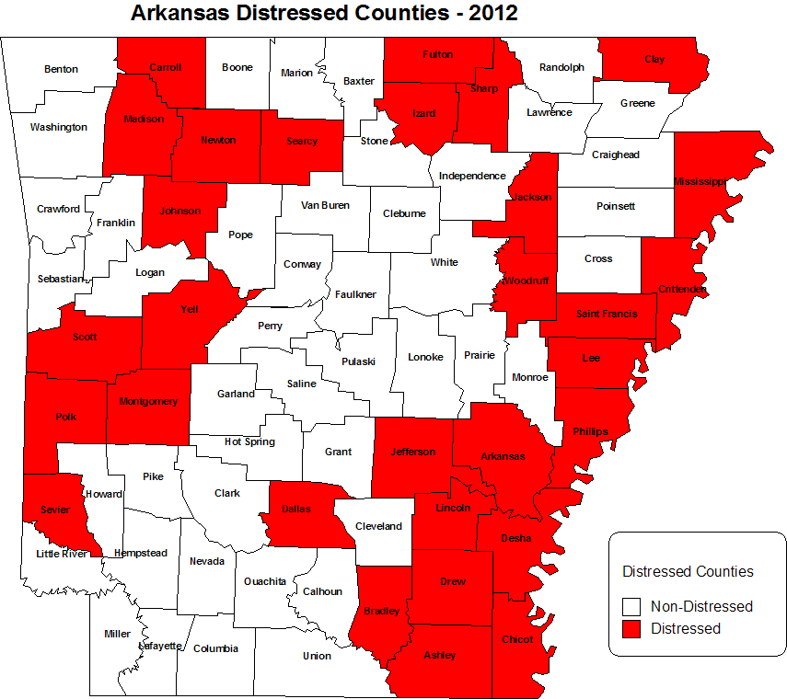
30 out 75 Arkansas counties are distressed, or 40% overall (30/75).
Notes:
As you see from this chart, many of Arkansas’ 30 distressed counties are in the eastern part of the state. There are several in the western half as well as depicted in this chart. What we want to do is communicate more the role that APAC plays and how we can provide assistance in pursuing government contracts.

Slide 29
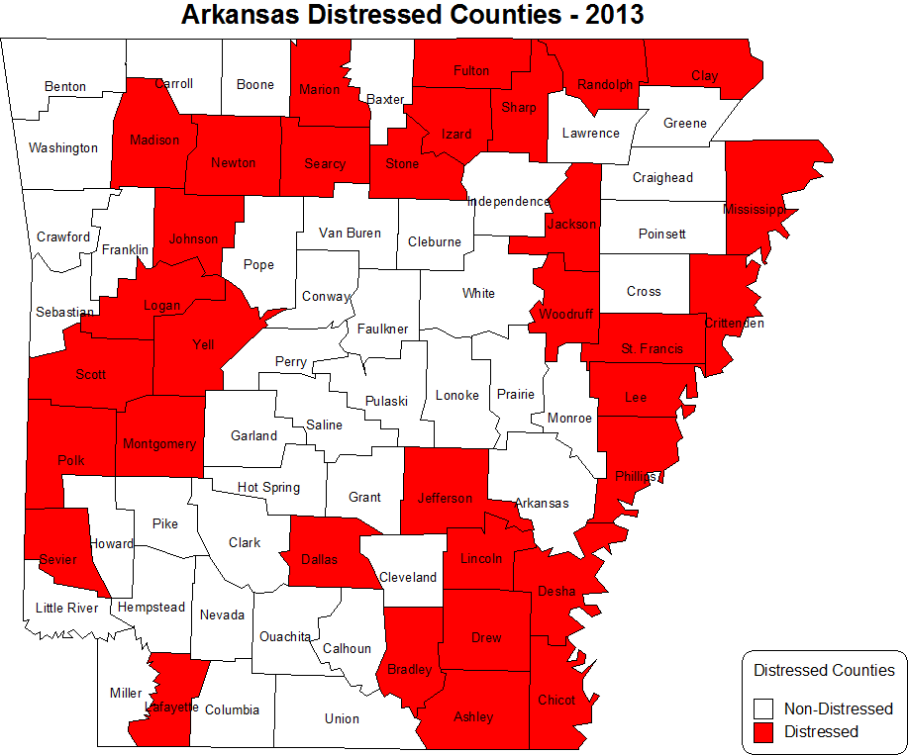
33 out 75 Arkansas counties are distressed, or 44% overall (33/75).
Added: Lafayette, Logan, Marion, Randolph and Stone
Deleted: Arkansas and Carroll

Slide 30
Contracting with the Government
  New regulations prohibit most “low bid” awards, emphasize quality
  Newer regulations emphasize “commercial practices” that result in less “red tape”
  It can be a steady business with some profit
  Government customers come back if vendor’s track record is good.
  Government pays its bills (eventually); no bad-debt write-offs.
  Prompt payment laws protect small businesses.
  As with most things, the process of government contracting becomes easier with experience.

Slide 31
APAC Believes in Collaboration
APAC is just one tool in the tool kit
Provides training through the Arkansas Small Business and Technology Development Center (ASBTDC)
Partners with SBA in providing training
Arkansas Economic Development Commission
Arkansas State Chamber of Commerce (Annual Procurement Conference)
Cooperative Extension Service has offices in all 75 counties

Slide 32
Construction Contracting
(20 March 2013)
8:00 – 8:30 A.M. – Registration
8:30 – 8:45 A.M. – Introductory Remarks: David Jerome, Director, APAC
8:45 – 9:15 A.M. – Bonding and Financial Considerations: Mr. Jay Coles, Deputy Director SBA – State of Arkansas
9:15 – 9:30 A.M. – A Contractor’s View of Construction Contracting
9:30 A.M. – 12:30 P.M. – Construction Contracting: Mr. Ray Blevins
State Construction Contracting
Bid Procedures
Arkansas Vendor Manual
State Types of Solicitations
Bonds
(10 Minute Break)

Slide 33
Construction Contracting
20 March 2013 (Cont.)
Federal Construction Contracting
Bid Procedures
Federal Acquisition Regulation Part 36
Davis Bacon Act
Federal Types of Solicitations
Bonds
Contract Award Process
Notification
Pre-Performance Conference
Contract Administration Procedures
Conclusion
Questions and Answers
Complete evaluations prior to departure (please leave at registration table)

Slide 34
Conclusion
Arkansas businesses produce high quality products and services – both of which are in high demand by the government.
Arkansas businesses can make a tremendous contribution to the state’s economy by bringing revenue into the state.
Arkansas businesses can create meaningful and sustainable jobs.
Partner with APAC and together we can do our part in making Arkansas even stronger!

Slide 35
How To Reach Us
Arkansas Procurement Assistance Center
2301 South University Avenue
Little Rock, AR 72204-4940
apac@uaex.edu
501-671-2393/Fax 501-671-2394
http://www.arcommunities.org/APAC.htm
…or any County Extension Office
“Helping Arkansas firms serve & supply public agencies nationwide”
Notes:
Hand out business cards and other literature, as appropriate depending on the audience.

Slide 36

2013 Legislative Update
SB54 – Buy American Iron & Steel
HB2031 – Not-for-profit priority buying
of surplus property
HB1803 – Non emergency transportation – DHS
SB422 – Exemptions from procurement law; ADC – Resale & crop production chemicals & seed; Everyone - Repairs for hidden damages

Slide 37
Bills continued…
SB882 – Minority definition expanded
HB1130 – Allow HE to purchase vehicles from local dealers if they can match the price
SB440 – Technology access for the blind or visually impaired

Slide 38

Shell Bills to Watch
SB1153 – Shop Arkansas
SB1085 – Awarding construction management contracts
HB1383 – Amend the law to make more uniform & contracts for the renovation of historic sites
SB863 – Amend the Administrative Procedures Act
SB340 – Guaranteed Energy Savings

Slide 39
AR NIGP Conference
“Massaging Your Procurement Muscles”
March 24 – 26, 2013
Clarion On The Lake
Hot Springs, Arkansas

Slide 40

Questions????

Slide 41
April Next Meeting
Next meeting is April 11, 2013 from 10 – 11:30 at the UA Cooperative Extension Auditorium
On the Agenda:
  New Associate’s Degree Program in Public Procurement at ASU Beebe
  Procurement Conflict of Interest Laws- Ray Pierce, OSP Attorney

