Slide 1

State-of-the-States 2017:
Infrastructure Consolidation and Optimization
Doug Robinson, NASCIO Executive Director

Slide 2


About NASCIO
National association representing state chief information officers and information technology executives from the states, territories and D.C.
NASCIO's mission is to foster government excellence through quality business practices, information management, and technology policy.
NASCIO provides members with products and services designed to support the challenging role of the state CIO, stimulate the exchange of information, and promote the adoption of IT best practices and innovations.
@NASCIO

Slide 3

2017 budget cuts in many states.Budgets for FY 2018 remain cautious – 1% growth. CIOs pressured to find cost savings, driving consolidation, optimization strategies.
Continued evolution from the owner-operator business model for CIOs – focus on services and hybrid models of delivery
Cybersecurity as a business risk. Ransomware, hacktivism and evolving threats. Enterprise strategy, communication and talent
Growing investments in cloud services, data analytics, mobile
Advocating for IT modernization, agile approaches, procurement reform
Continuing IT workforce challenges: retirements, skills gap, recruiting, talent management, workplace innovation

Slide 4






Top Ten: State CIO Priorities for 2017
1. Security
2. Consolidation/Optimization
3. Cloud Services
4. Budget and Cost Control
5. Legacy Modernization
6. Enterprise IT Governance
7. Data Management and Analytics
8. Enterprise Vision and Roadmap for IT
9. Agile and Incremental Software Delivery
10. Broadband/Wireless Connectivity
Source: NASCIO State CIO ranking, November 2016

Slide 5

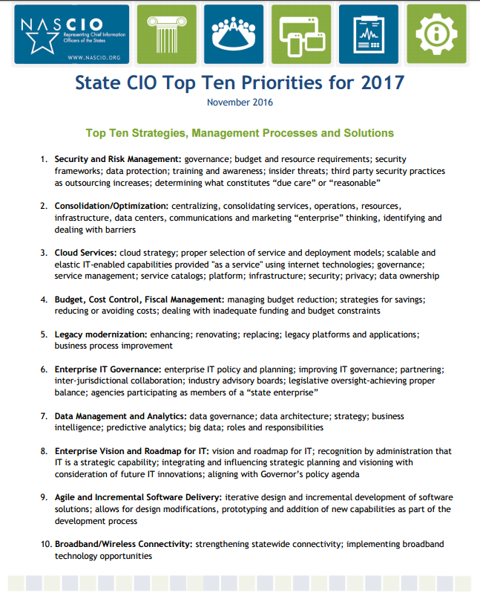
Consolidation has been on the State CIO Top Ten Priorities list consistently since 2006

Slide 6
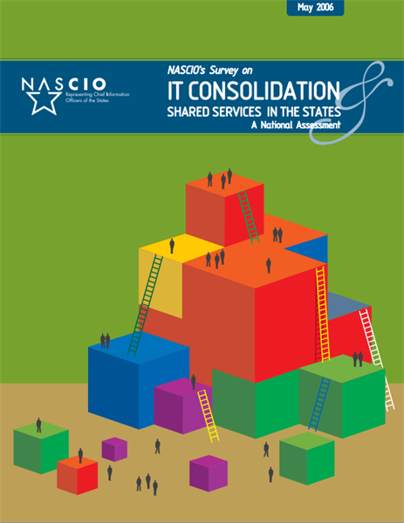
Key Findings:
“strong trend towards states consolidating key IT functions and utilizing the shared services model whenever applicable.”
“most consolidation initiatives were begun in the state CIO’s offices in tandem with either the governor’s office or the state legislature.”

Slide 7
Targets of Enterprise Consolidation
Data Centers
E-mail/Collaboration
Telecom/Networks
Servers
Storage
Desktops
Content Management
Security
Help Desk
Software Licenses
  Disaster Recovery/Back Up
  Automation Tools
  Application Development
  Business Intelligence/Analytics
  Project Management
  Imaging/Archiving
  Mobile Device Management
  Identity Management
  Contracts
  IT Staff

Slide 8

Rationale for IT Consolidation
Economies of scale – reduce operational costs
Strengthen IT security
Promote enterprise integration and applications
Introduce process standards: ITIL and ITSM
Improved support for legacy systems
Centralize infrastructure maintenance and upgrades
Improve disaster recovery/business continuity
Reinvestment of spend to services
Reduce diversity and complexity of environment – cost savings

Slide 9
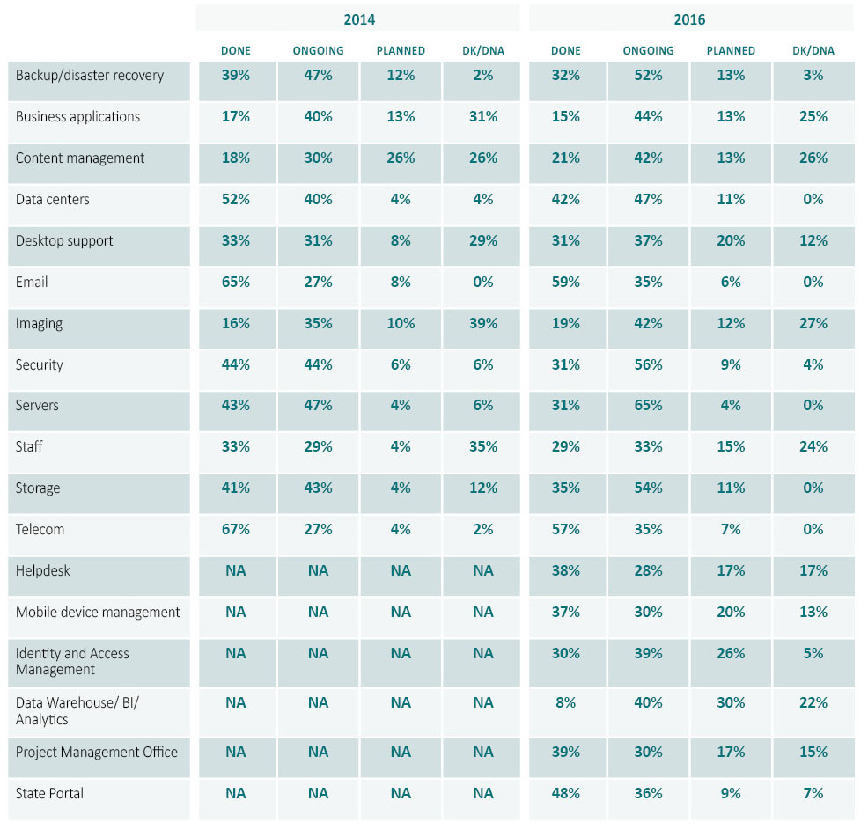
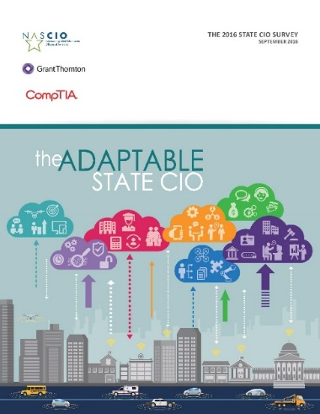
Status of Infrastructure Consolidation

Slide 10
Enterprise Data Center Consolidation
Source: NASCIO 2016 State CIO Survey
NH
WA
VT
ME
MT
ND
OR
MN
MA
ID
SD
WI
NY
MI
RI
WY
IA
PA
NJ
CT
NV
NE
OH
UT
IL
IN
DE
CA
CO
WV
VA
MD
KS
MO
KY
TN
NC
DC
AZ
OK
AR
SC
GU
NM
MS
AL
GA
TX
LA
HI
FL
PR
AK
Consolidated
KEY:
In progress
VI
Planned

Slide 11
Challenges to Consolidation Initiatives
Agency/workforce resistance to change
Agencies desire to remain autonomous
Problems moving infrastructure from the agencies
Backlash when consolidation doesn’t meet agency business needs
Higher than projected costs
Seeking exemptions from federal statutory and regulatory requirements
Lack of funding/investment to prepare for consolidation

Slide 12
State of Ohio Story:
Consolidation, Optimization, Collaboration
2011: 32 data centers spread across 26 cabinet agencies, over 9,000 servers, and 19 different email systems
Data center had not been updated in 20 years
Consider: buy-in from stakeholders? How to finance? Work with private sector?
IBM is private partner: $267 million, 10-year contract
Savings to state: $100 million+ to date
Tenants: The Ohio State University, Cuyahoga County – each see savings in millions (avoid capital investment + yearly savings)
Notes:
http://das.ohio.gov/Portals/0/DASDivisions/InformationTechnology/IS/Optimization/2016%20NASCA%20Ohio%20Case%20Study.pdf

Slide 13

Critical Success Factors
Strong support from the Governor
Choosing the correct implementation strategy to ensure buy-in
Workforce impact - motivating staff through the transition
Establishing trust with stakeholders
Effective governance model with a shared vision

Slide 14

The Success Playbook
Have a plan - defined process with gap analysis
Document the “as is” - baseline of assets
Spend analysis: capture the known costs; hidden costs
Engage the agency stakeholders early
Constant communication – expect resistance
Address federal cost allocation
Re-negotiate existing contracts
Manage expectations and expect surprises
Create aggressive roadmap with reasonable milestones
Capture and report cost savings
Establish a governance structure for shared decision-making

Slide 15
What Do We Know? Patterns of Success in States
Enterprise IT Leadership and Governance
Statewide Enterprise and Application Architecture
Consolidation and Optimized IT Spending
Enterprise Project, Portfolio and Investment Management
Statewide Security and Risk Management
Business Transformation Enabled by Technology

